Slide 1
Latest Treatments for Heart Valve Problems Emerging Structural Heart Procedures
Srinivas Iyengar, MD
Structural Heart Director, Boulder Heart
720-709-1807

Slide 2
Background
Historically, a number of cardiac conditions could only be treated with open heart surgery.
Given the increasing age of our population, in addition to the multiple co-morbid issues involved, the risk of complications of operating on this population has also gone up.
Medical technology has made leaps and bounds in the last decade in regard to treating CV disorders.

Slide 3
Background
Thirty years ago: use of coronary balloons (PTCA), followed by stents revolutionized acute coronary syndromes, i.e., “heart attacks.”
Pacemakers implanted w/o open heart surgery changed the dynamic of heart rhythm disorders.
The one major area that was not successfully addressed: structural heart, i.e., valves, appendage.
Major changes in the last decade…

Slide 4
Structural Heart Revolution
Revolution, not just evolution!
We now have the capability to address serious internal cardiac issues with minimally invasive techniques.
Results, with certain procedures, have now shown to be equivalent if not better with certain conditions than surgical standard of care.
And this movement only seems to be gaining strength with newer technologies entering the cardiac arena every year.

Slide 5
Mitral Regurgitation
Affects thousands of Americans
Vastly undertreated
Basically means the mitral valve has become “leaky”- blood spills backwards into the lungs rather than going forward into the left ventricle as a result of weak or “degenerated” mitral leaflets.
Results in progressive shortness of breath, fatigue, and eventual heart failure.

Slide 6

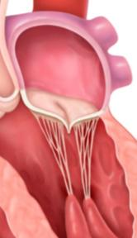
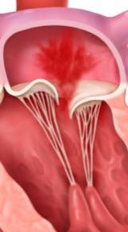
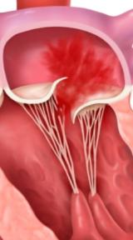
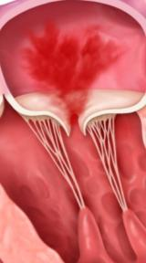
Mitral Regurgitation Etiologies
Causes
Degenerative MR (also known as primary or organic MR) is usually due to an anatomic abnormality of the mitral valve itself, including the leaflets, and/or the subvalvular apparatus, such as the chordae or papillary muscles.
Functional MR (also known as secondary MR) is the result of left ventricular dilation, which can be secondary to ischemic heart disease. Left ventricular dysfunction leads to annular dilation and incomplete coaptation of the mitral valve resulting in MR.
Normal
Mitral Valve
Degenerative
MR: Prolapse
Degenerative
MR: Flail
Functional MR
Notes:
6

Slide 7
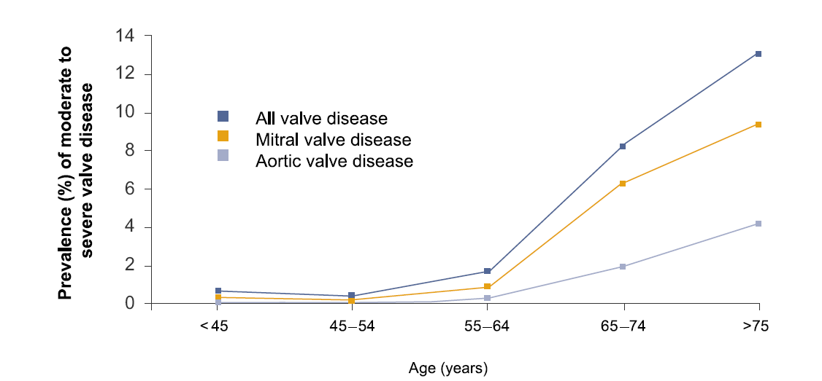
Moderate or Severe Valvular Disease is Common and Increases With Age
Mitral regurgitation is the most common type of heart valve insufficiency in the US^{1,2}
Prevalence increases with increasing age, from 0.5% for 18-44 year olds rising to 9.3% for ≥75 year olds (p<.0001)
Prevalence of Valvular Heart Disease by Age
1. Heart Disease and Stroke Statistics 2010 Update: A Report From the American Heart Association. Circulation. 2010;121:e46-e215.
2. Nkomo et al. Burden of Valvular Heart Diseases: A Population-based Study, Lancet, 2006; 368: 1005-11.
Notes:
7
7
Focus of this slide is on REGURGITANT DISEASE...

Slide 8
MR Progresses to Heart Failure
Increasing Mitral Regurgitation
1 year mortality
up to
57%¹
MR initiates a cascade of events progressing to heart failure, then death, if untreated.^{2,3}
Dilation of
Left Ventricle
Increase Load/Stress
Dysfunction
of Left Ventricle
Muscle Damage/Loss
¹ Cioffi G, et al. Functional mitral regurgitation predicts 1-year mortality in elderly patients with systolic chronic heart failure. European Journal of Heart Failure 2005 Dec;7(7):1112-7
² Grigioni F, et al. Outcomes in mitral regurgitation due to flail leaflets a multicenter European study. JACC Cardiovasc Imaging. 2008 Mar;1(2):133-41
³ Enriquez-Sarano M, et al. Quantitative determinants of the outcome of asymptomatic mitral regurgitation. N Engl J Med. 2005 Mar 3;352(9):875-83

Slide 9
Treatment
Historically, only medical therapy, followed by surgery (if possible) were mainstays of treatment.
Medical therapy, though effective in many cases, cannot reverse degenerative disease.
Surgery is the gold-standard (and still is).
However, surgery can be high-risk in this population, and needs to be done by a surgeon with the skill/experience to perform a MV replacement/repair.

Slide 10
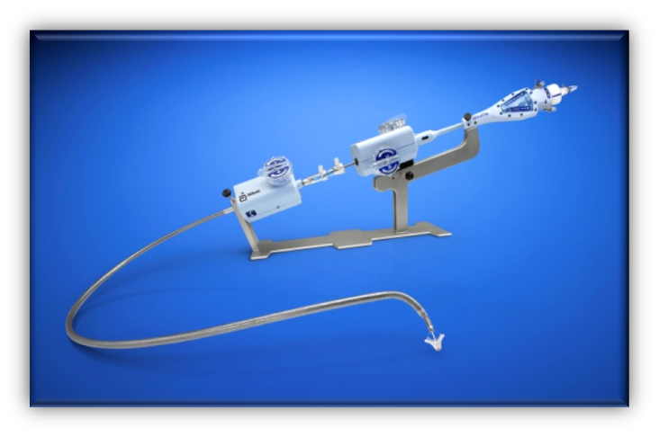
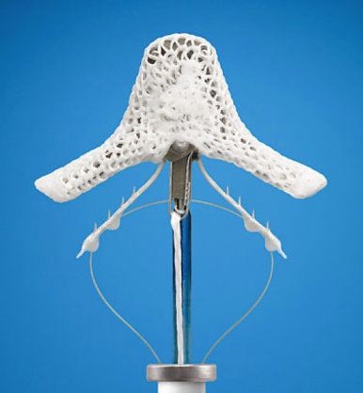
MitraClip System First-in-class, Leading Technology
The MitraClip System performs percutaneous mitral valve repair by creating a vertical line of coaptation, forming a double-orifice valve. ^{1,2}
Beating heart procedure—no cardiopulmonary bypass
Allows for real-time positioning and repositioning to optimize MR reduction
Designed to preserve surgical options
Femoral venous access
Low hospital length of stay
1. MitraClip Clip Delivery System Summary of Safety and Effectiveness Data (SSED)
2. MitraClip Clip Delivery System Instructions for Use.
See important safety information referenced within
Notes:
Concept based on a surgical repair technique

Slide 11


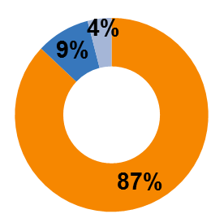

Successful Outcomes for Patients and Centers Post-procedure Impact of MitraClip Therapy
10.1 days
73%
2.9
days
EII Prohibitive
Risk DMR
MitraClip (N=127)
Partner B TAVR (N=175)
Low Hospital Length of Stay vs. TAVR^{1,2}
87% of MitraClip patients discharged to home³
73% reduction in hospitalization rate⁴
Majority of MitraClip patients discharged to home with or without home health care (9% to nursing home/skilled nursing facility, 4% died prior to discharge)
HF hospitalization rates per patients decreased from 0.67 (1 year prior to MitraClip therapy) to 0.18 (1 year post discharge)
¹ MitraClip Clip Delivery System Summary of Safety and Effectiveness Data (SSED)
² Reynolds et al. Circulation. 2012;125:1102-1109.
³ Data on file at Abbott Vascular.
⁴ MitraClip Clip Delivery System Instructions for Use.
See important safety information referenced within.

Slide 12
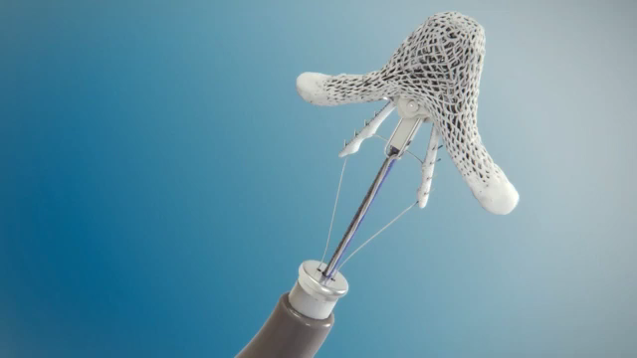
MitraClip Video

Slide 13
Aortic Stenosis
Aortic stenosis (AS) can be seen earlier in life as a congenital issue, i.e., bicuspid valve, but is more often seen as a calcific, age-related issue.
Calcific aortic stenosis - a very real problem in the U.S.
Results in closure of the aortic valve, which causes progressive angina, syncope, light-headedness, and eventual heart failure/death.

Slide 14

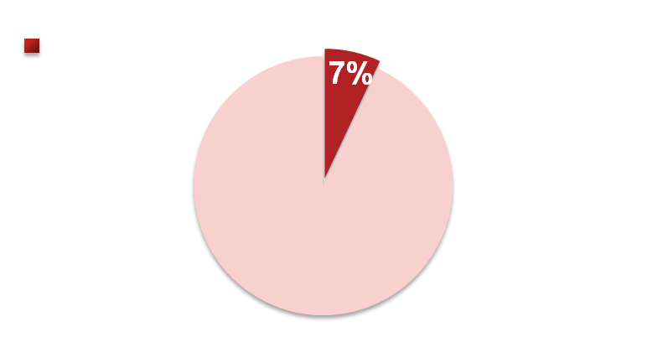
Prevalence of Aortic Stenosis
Aortic stenosis is estimated to be prevalent in up to 7% of the population over the age of 65.¹
It is more likely to affect men than women; 80% of adults with symptomatic aortic stenosis are male.³
16.5 Million People in US
Over the Age of 65²
Percentage Diagnosed with Aortic Stenosis
Notes:
Aortic stenosis is a common public health problem affecting millions of people in the United States. It is estimated to be prevalent in up to 7% of the population over the age of 65. It is also
more likely to affect men than women; 80% of adults with symptomatic aortic stenosis are male.

Slide 15
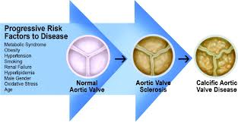
Aortic Stenosis Demographics
Aortic stenosis 2% US population > 65 yrs old
Aortic sclerosis 29% US population > 65 yrs old
Aortic sclerosis 50% greater risk of mortality and myocardial infarction
Aortic sclerosis progresses to aortic stenosis in 9% over 5 years

Slide 16
What Causes Aortic Stenosis in Adults?
More Common
Age-Related Calcific Aortic Stenosis
Aortic stenosis in patients over the age of 65 is usually caused by calcific (calcium) deposits associated with aging.
Rheumatic Fever
Adults who have had rheumatic fever may also be at risk for aortic stenosis.
Congenital Abnormality
In some cases adults may develop aortic stenosis resulting from a congenital abnormality.
Less Common
Notes:
There are various causes of aortic stenosis. Aortic stenosis in patients over the age of 65 is usually caused by calcific (calcium) deposits associated with aging. It can also be caused by infection, rheumatic fever, or a congenital abnormality.

Slide 17

Major Risk Factors
Independent clinical factors associated with degenerative aortic valve disease include the following: ⁴
Increasing age
Male gender
Hypertension
Smoking
Elevated lipoprotein A
Elevated LDL cholesterol
Notes:
Independent clinical factors associated with degenerative aortic valve disease include the following increasing age, male gender, hypertension, smoking, elevated lipoprotein A, elevated LDL cholesterol

Slide 18
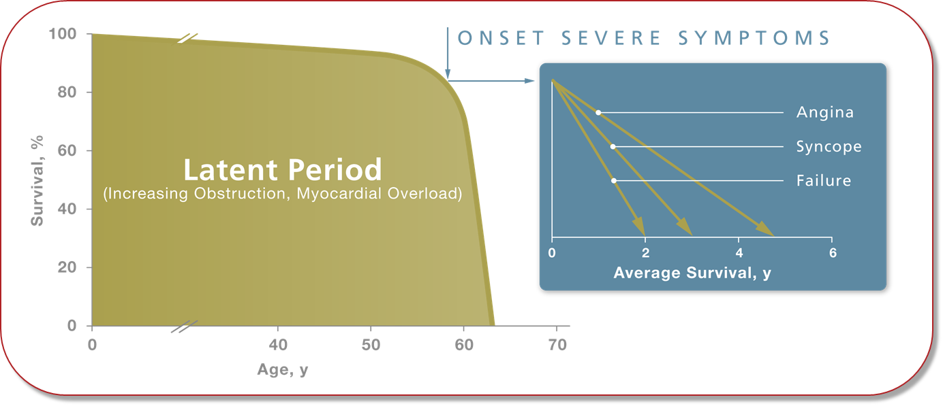
Aortic Stenosis is Life Threatening and Progresses Rapidly
Survival after onset of symptoms is 50% at 2 years and 20% at 5 years. ¹
Surgical intervention for severe aortic stenosis should be performed promptly once even minor symptoms occur. ¹
Notes:
Literature shows
- Survival after onset of symptoms is 50% at 2 years and 20% at 5 years
- Surgical intervention for severe aortic stenosis should be performed promptly once even minor symptoms occur

Slide 19
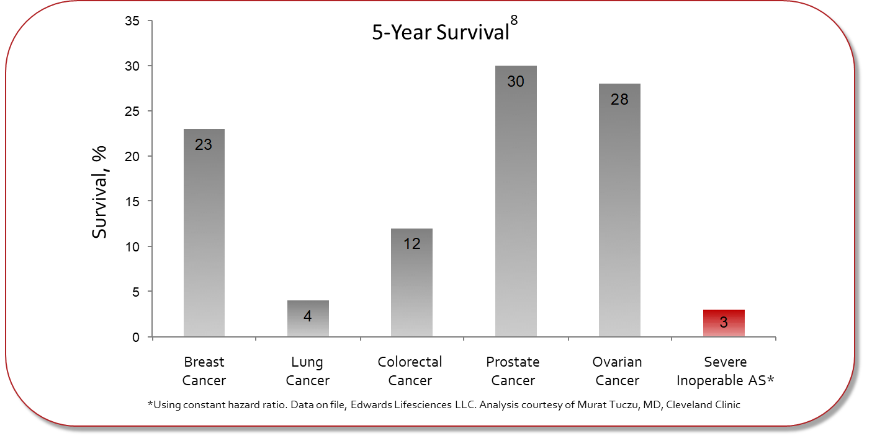
Sobering Perspective
5-year survival of breast cancer, lung cancer, prostate cancer, ovarian cancer and severe inoperable aortic stenosis.
Notes:
Data shows a sobering perspective for inoperable patients: 5 year survival of breast cancer, lung cancer, prostate cancer, ovarian cancer and severe inoperable aortic stenosis

Slide 20
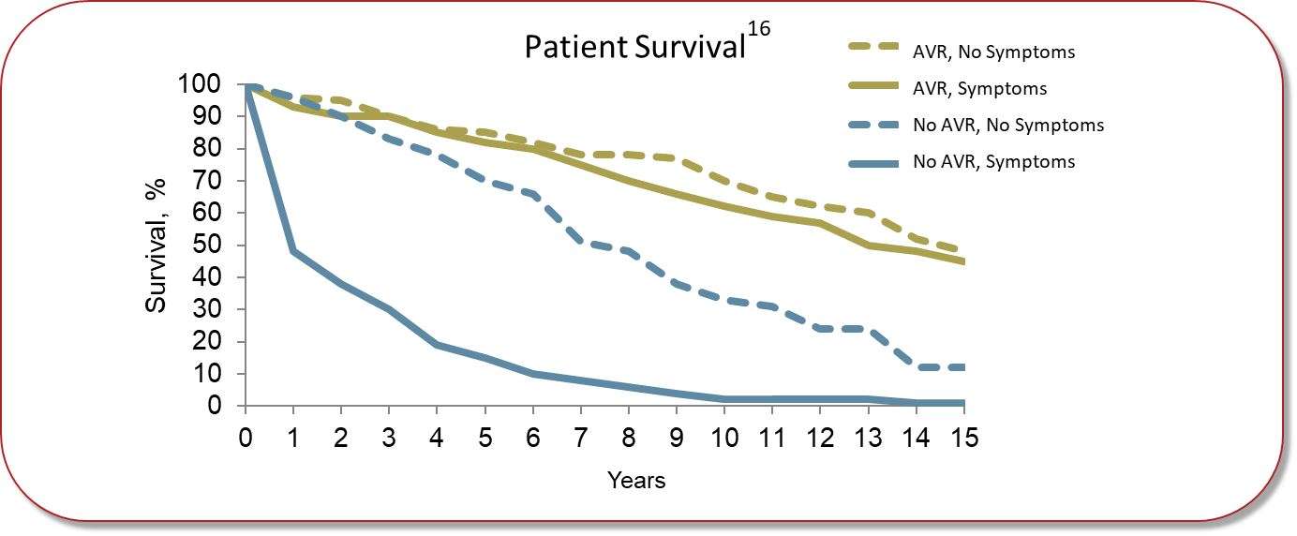
Aortic Valve Replacement Greatly Improves Survival
Study data demonstrate that early and late outcomes were similarly good in both symptomatic and asymptomatic patients.
It is important to note that among asymptomatic patients with SAS, omission of surgical treatment was the most important risk factor for late mortality.
Notes:
Study data demonstrate that early and late outcomes were similarly good in both symptomatic and asymptomatic patients
It is important to note that among asymptomatic patients with SAS, omission of surgical treatment was the most important risk factor for late mortality

Slide 21
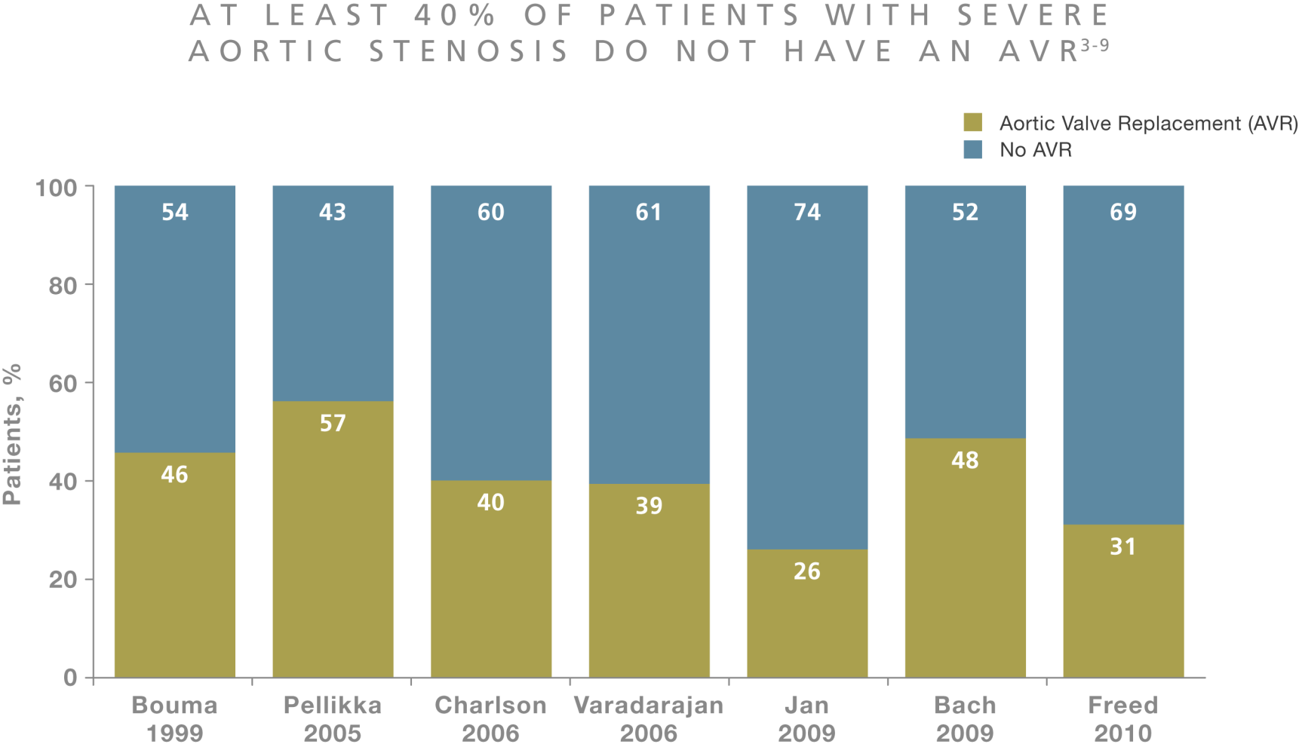
Low Percentage of Aortic Valve Surgery
Studies show at least 40% of patients with severe AS are not treated with an AVR9-15.
Notes:
Studies show at least 40% of SAS patients are not treated with an AVR⁹⁻¹⁵

Slide 22
Aortic Valve Replacement
Open heart surgery becomes riskier with the older population.
The need for long hospital stays, rehab, and treatment of co-morbid issues are major factors.
The last ten years has seen a revolution in AS therapy.
TAVR has become a viable technology in the treatment of AS.

Slide 23
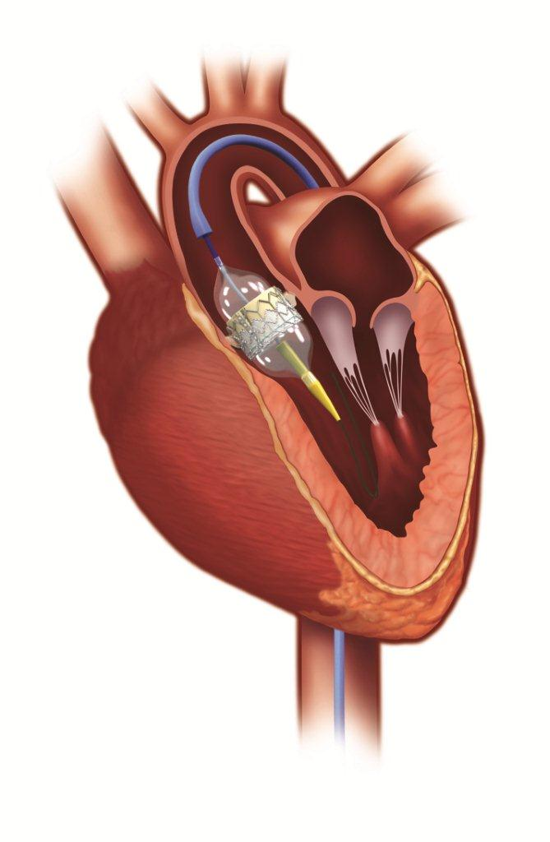
What is TAVR-Transcatheter Aortic Valve Replacement?
An aortic valve replacement as an alternative to traditional thoracotomy.
Less invasive than traditional thoracotomy for patients considered too high risk for traditional surgery.
Notes:
If a cardiac surgeon determines that you are too sick for open-heart surgery and if medicine is not helping you feel better, TAVR may be an alternative. This less invasive procedure allows your aortic valve to be replaced with a new valve while your heart is still beating.

Slide 24
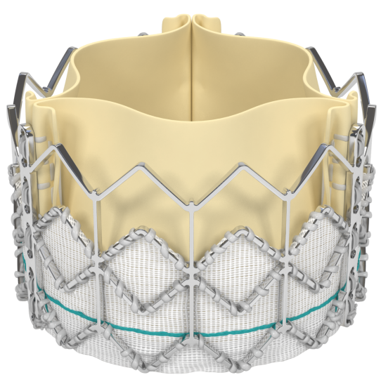
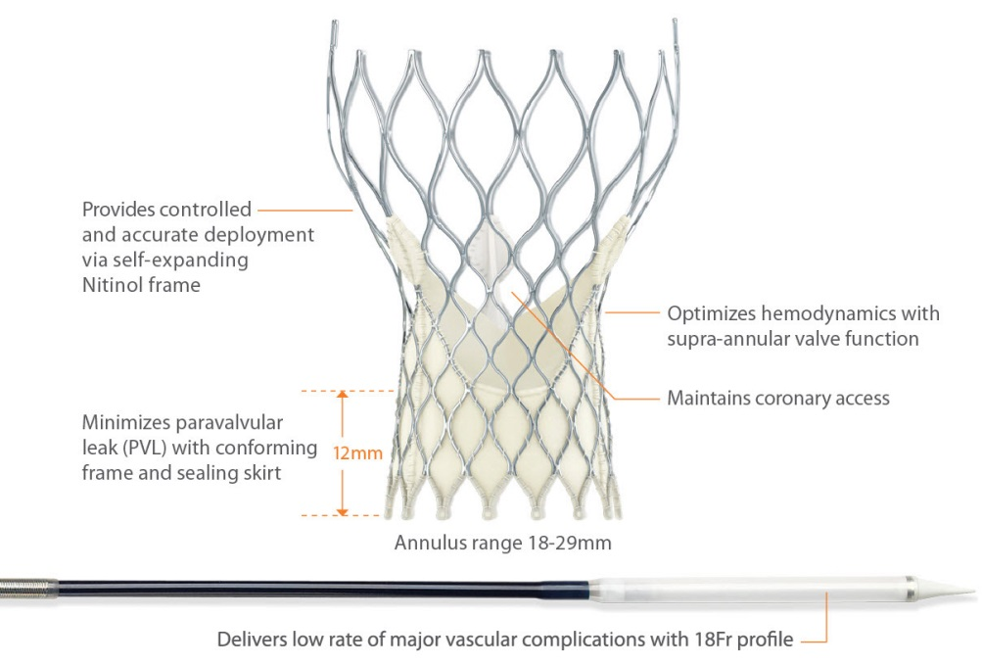
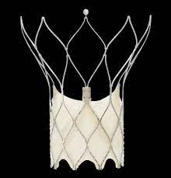
Three TAVR Options
Edwards Sapien Valve
Stainless Steel Frame
Medtronic Evolut FX +
Nitinol Frame-self expanding
Abbott Portico TAVR: only for high-risk/inoperable

Slide 25
Medtronic Evolut FX+
Excellent results from multiple studies for both approved valves.
Evolut: Recent studies have shown better results in high-risk patients receiving a trans-femoral Evolut as opposed to open heart surgery.
The question of long-term durability is still being examined.
TAVR now approved for all risk populations.

Slide 26
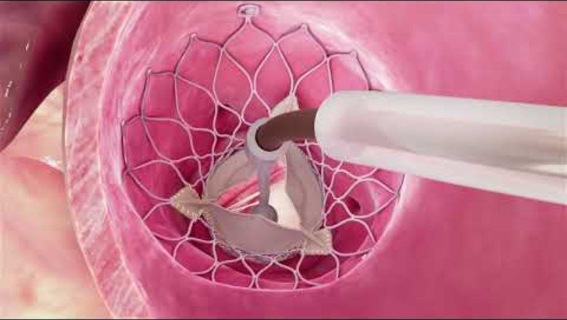
TAVR Video

Slide 27
Summary
Heart valve disease is growing in the U.S. population.
We need alternatives to standard surgical therapy for patients who are at higher risk for complications.
Both TAVR and Mitraclip represent the forefront of these therapies…but they are certainly not the last!

Slide 28
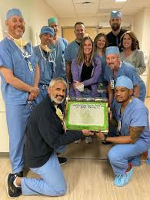
Thank You!!

Slide 29
Latest Treatments for Heart Valve Problems Emerging Structural Heart Procedures
Srinivas Iyengar, MD
Structural Heart Director, Boulder Heart
720-709-1807

