Slide 1

Equestrian Sports Medicine Injury Prevention & Recovery
Sherrie Ballantine-Talmadge, DO
CU Sports Medicine & Performance Center
Director of Outreach
720-680-3421

Slide 2
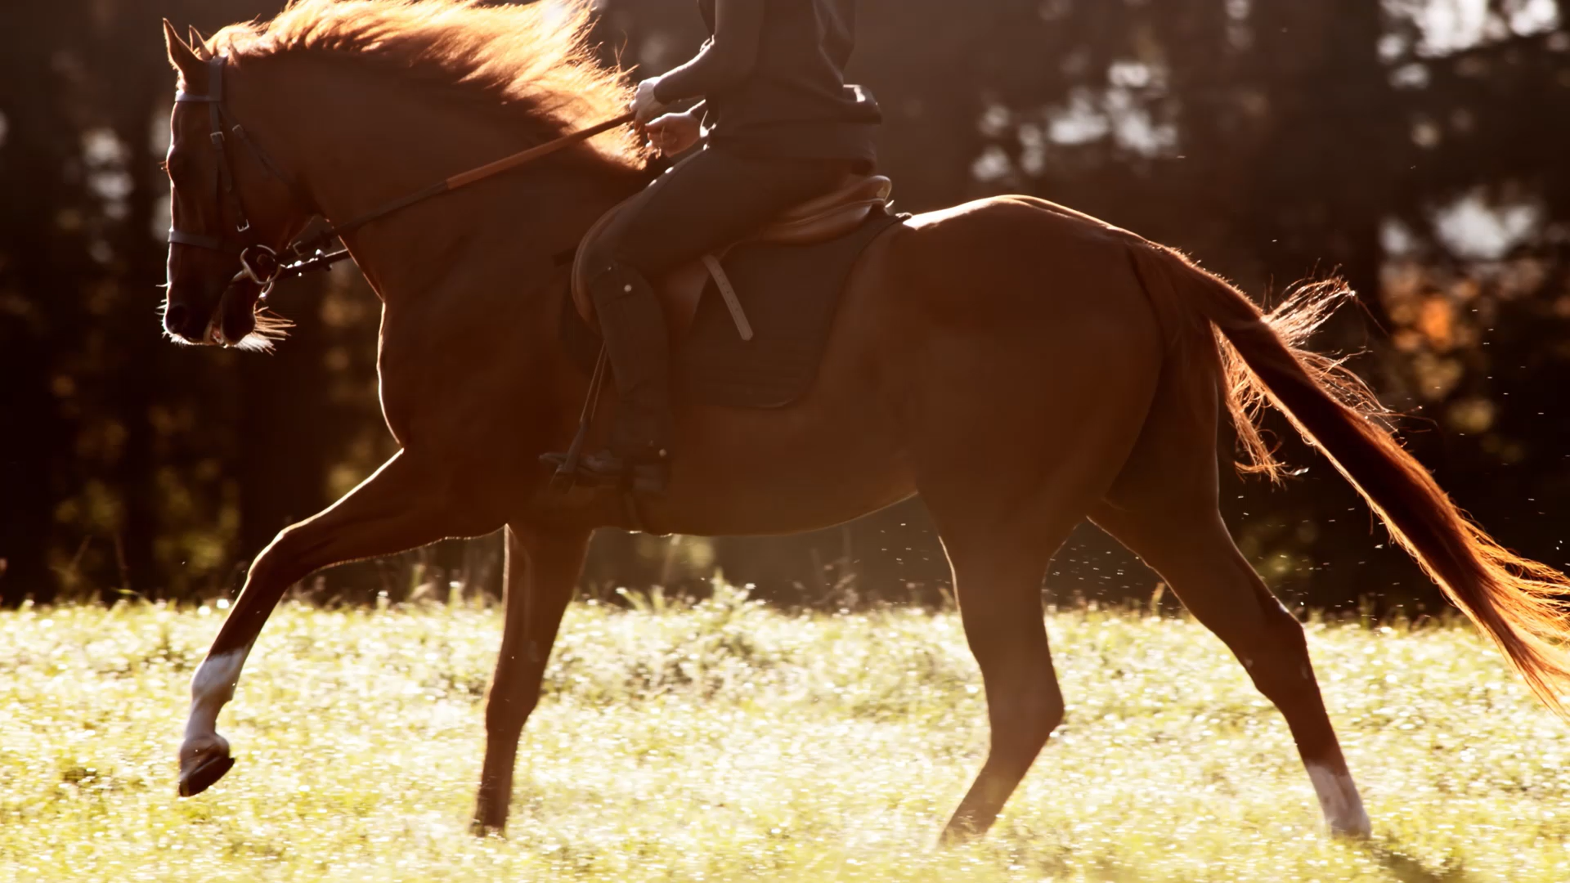
Staying Strong in the Saddle:
Challenging Beliefs

Slide 3
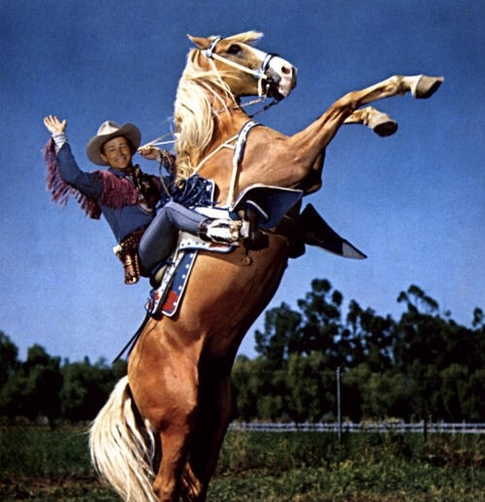
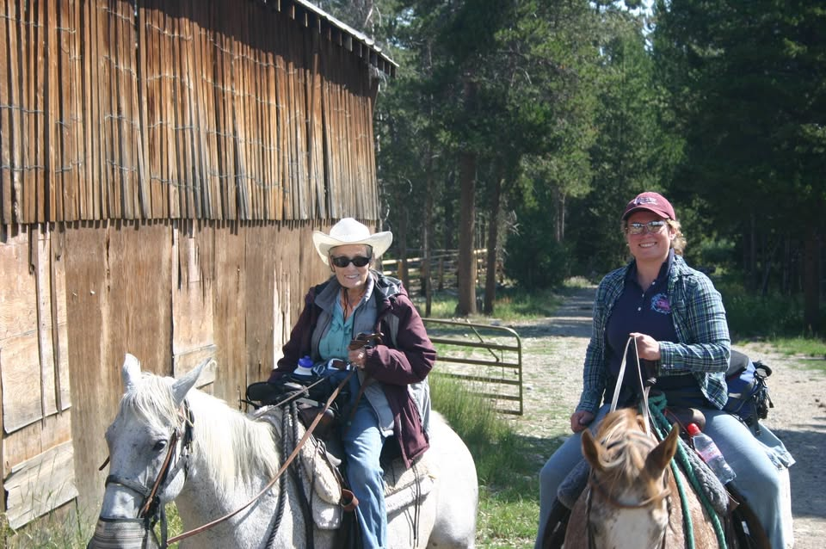
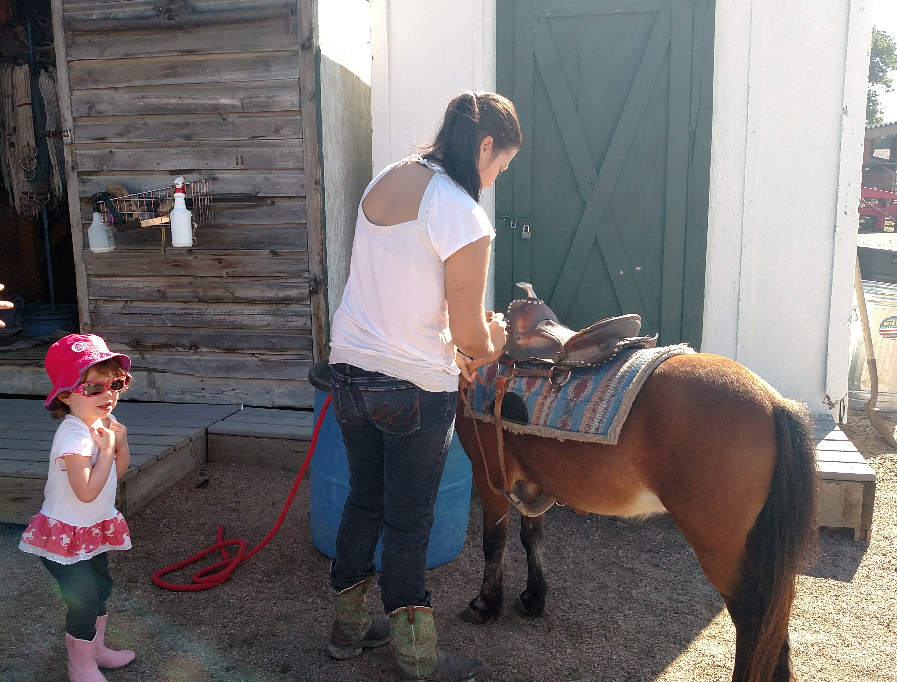
Why Equestrian Sports Medicine?

Slide 4
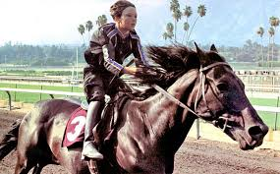
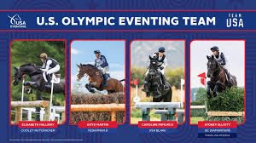
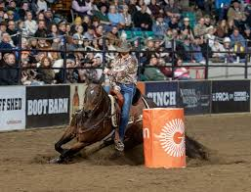
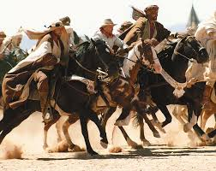
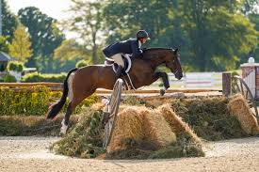
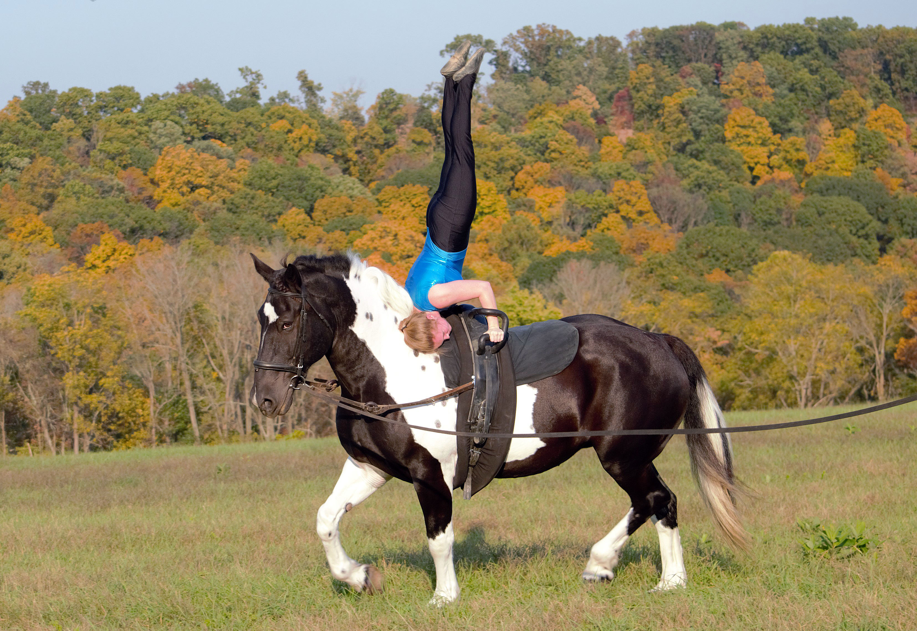
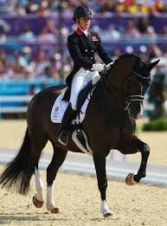
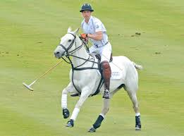
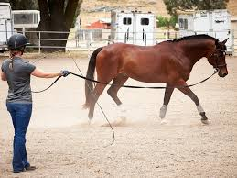
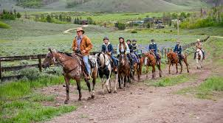
Equestrian? Sports?
Equestrian Sports Medicine???

Slide 5
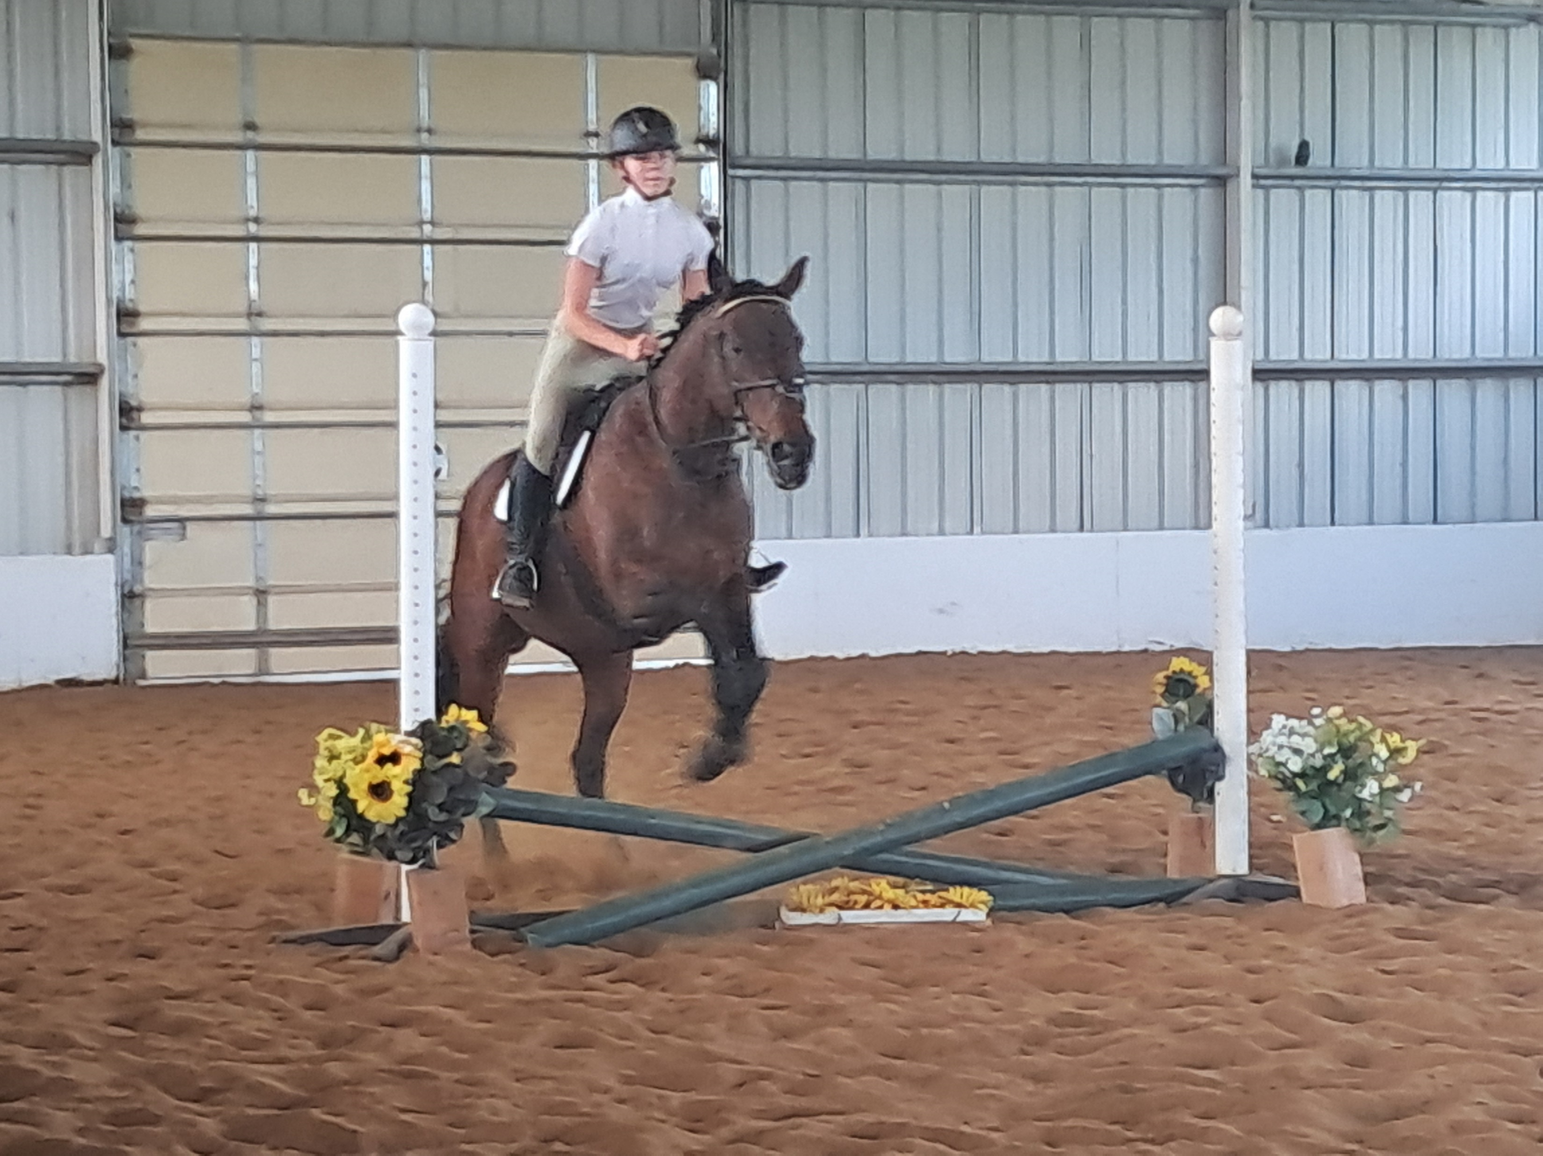
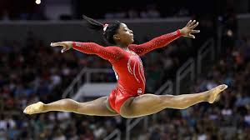
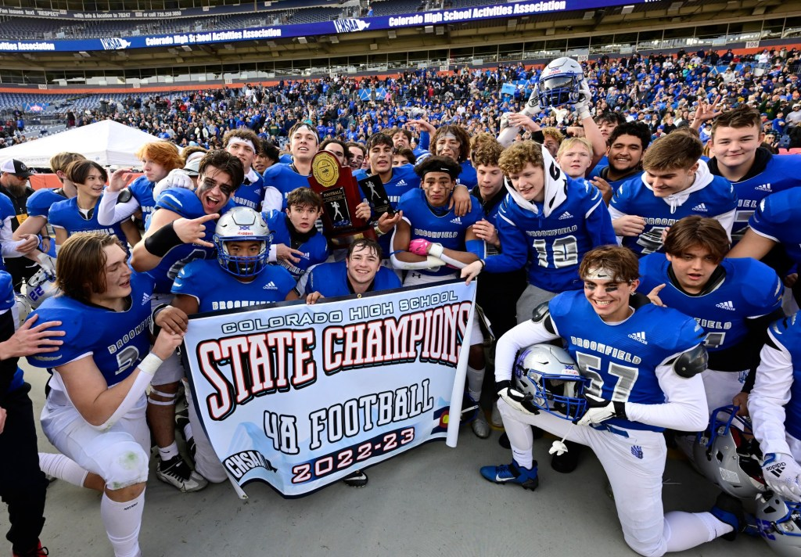
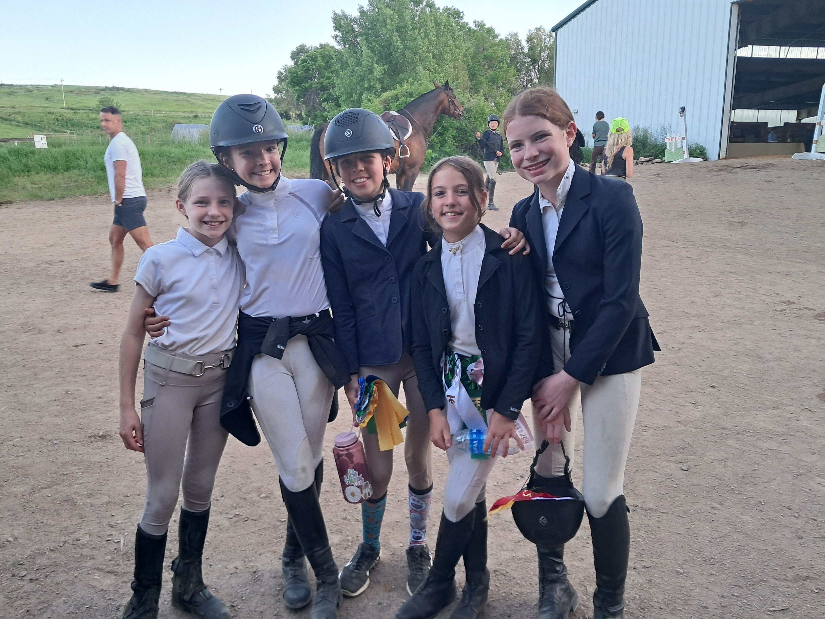
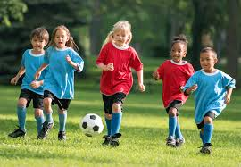
Equestrian Sports Medicine

Slide 6
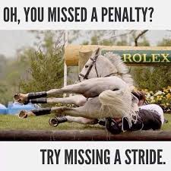
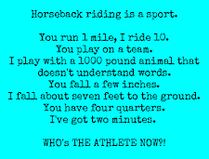
Belief #1
“Riding a horse isn’t really exercise or a sport.”
“Aren’t you just sitting there?”
“The horse does all the work, right?”

Slide 7
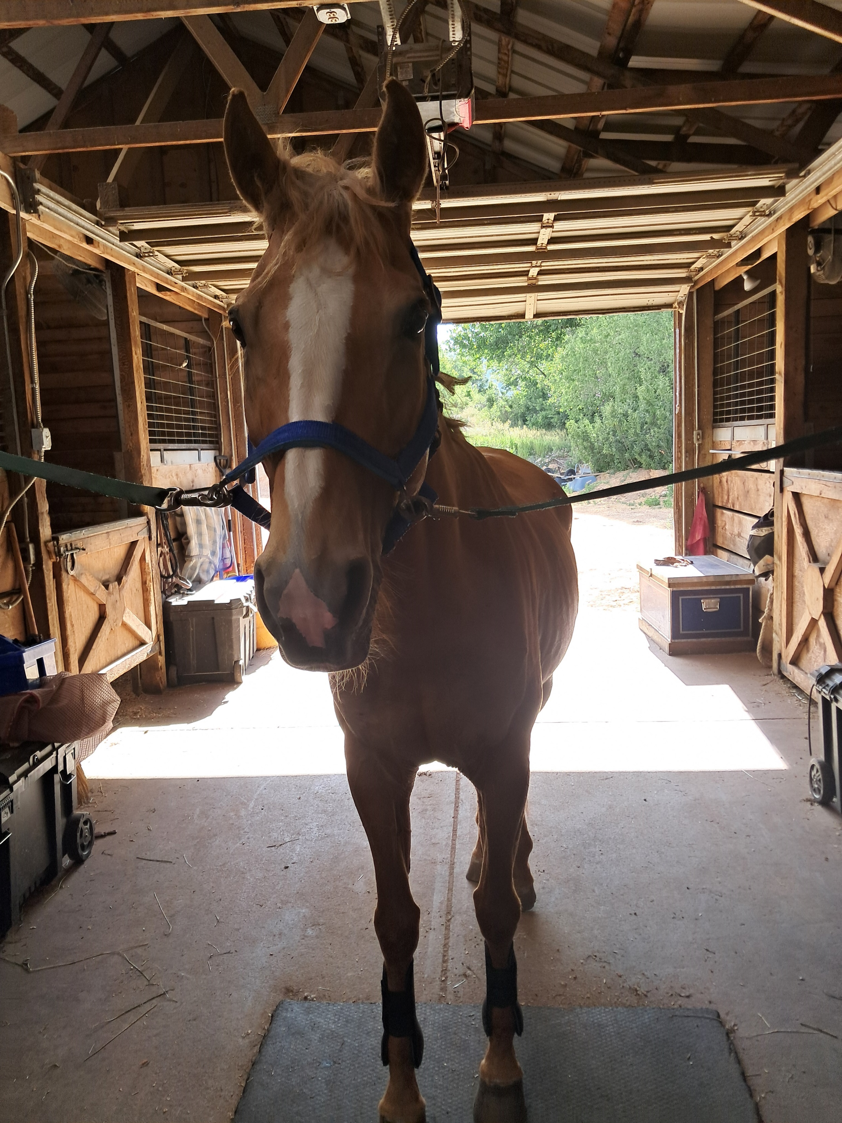
Check out this fun video Equestrian: Our Sport (Horse Riding Isn't Easy!)
https://www.youtube.com/watch?v=oHyEqmFE6CQ

Slide 8
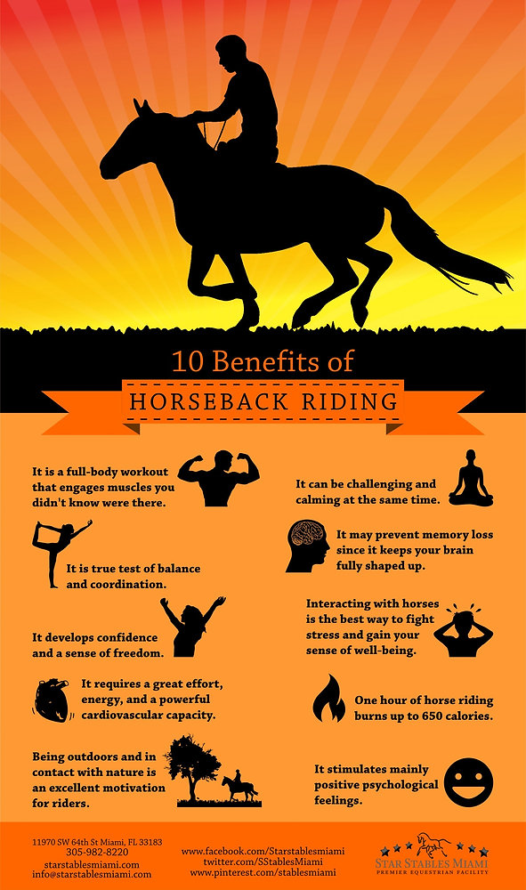
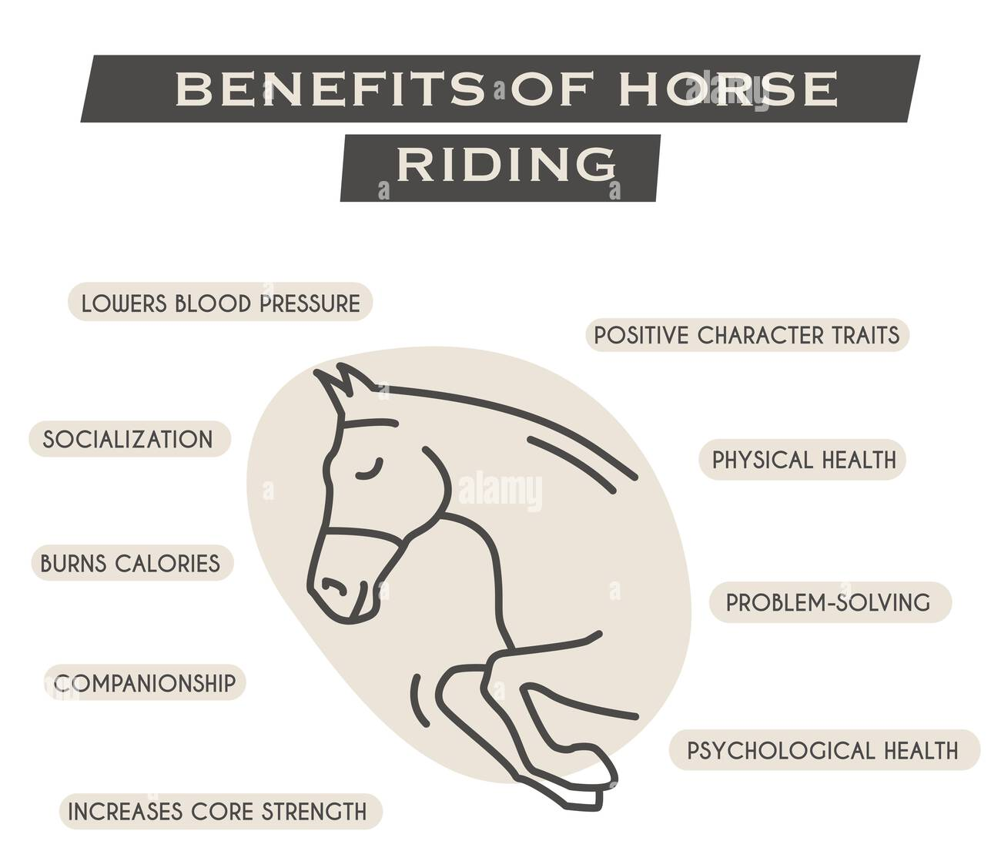
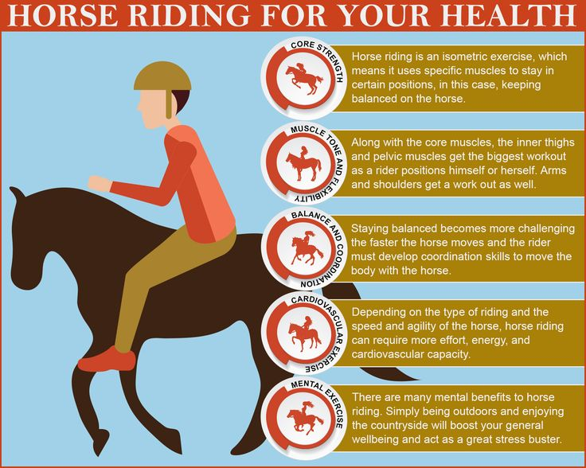
Belief #1: Riding a horse isn’t really exercise or a sport

Slide 9
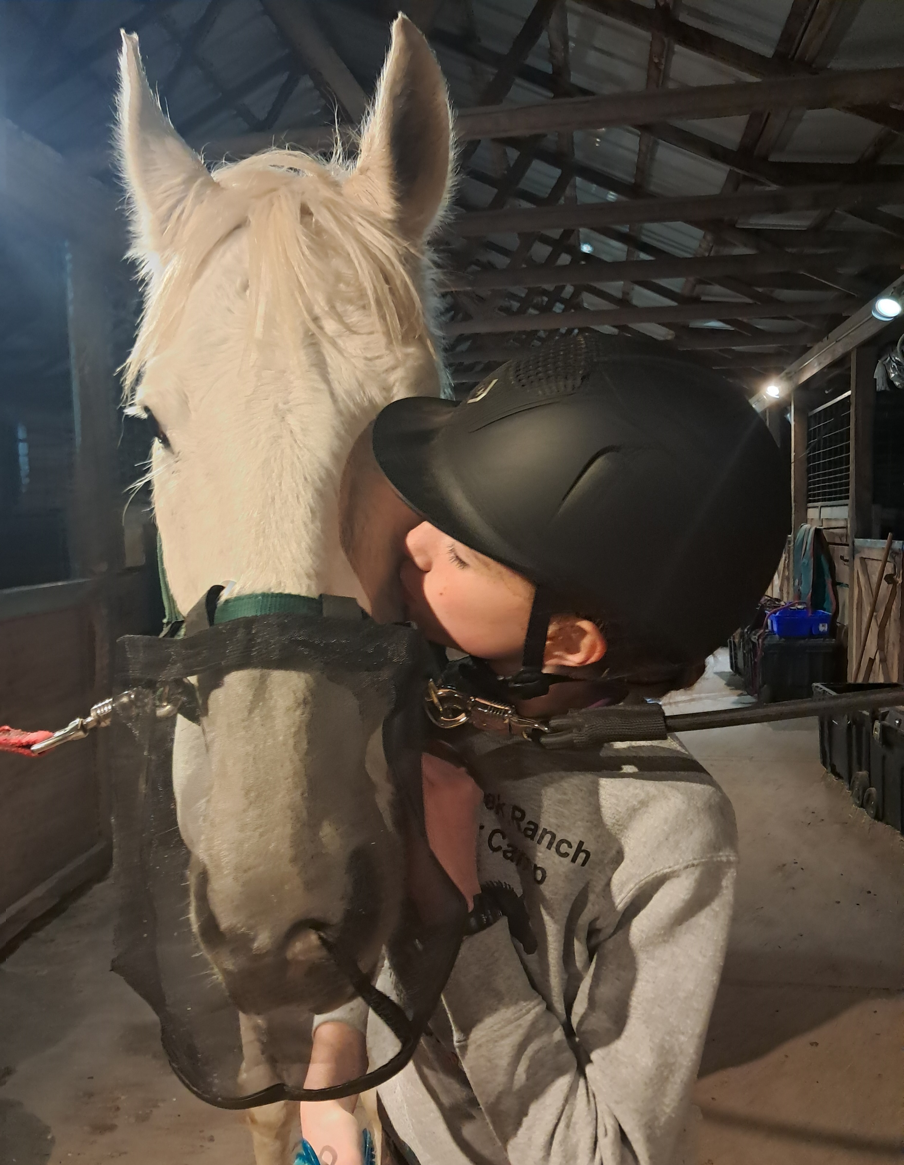
Belief #2
“I fell off my horse. Is my horse ok? I need to get back on.”
When accidents happen what does the equestrian think?
  “Is my horse ok?”
  “I am fine.”
  “I need to get back on.”
Can’t ride if you don’t have a body to ride with.
Partnership of horse and rider should extend to the wellness of both.
You can’t ride if you can’t think or use your body correctly.

Slide 10
Belief #2
“I fell off my horse. Is my horse ok? I need to get back on.”
Do equestrians identify as athletes?
  Yes…with some caveats
2023 study Journal of Physical Activity & Health by Keener et al “Self-Reported Physical Activity and Perception of Athleticism in American Equestrian Athletes” looked at perceptions of self-reported equestrian, barn work & non-equestrian physical activity spanning across the lifespan in an American equestrian population.
Survey across different levels of equestrian participation, across the USA, over 2,000 equestrians
  Females account for ~ 90% of sport participation in equestrian sports

Slide 11
Belief #2
“I fell off my horse. Is my horse ok? I need to get back on.”
Variety of different levels of equestrians: professionals, amateurs, recreational
  Recreational equestrians had a SIGNIFICANT difference in their perception of riding as a physical activity and sport vs the amateurs and professionals.
  Barn work and equestrian physical activity higher in professionals, then followed by the amateur equestrians and then the recreational equestrians.
  Non-equestrian physical activity significantly higher in professionals and amateurs than the recreational equestrians.
Conclusions: Equestrian physical activity meets aerobic and muscular recommendations set in the U.S.
  HOWEVER, it is dependent on the status of participation.
  Because equestrian activity meets these national guidelines, we can encourage equestrians, especially females, to engage in this activity over their lifetime.

Slide 12
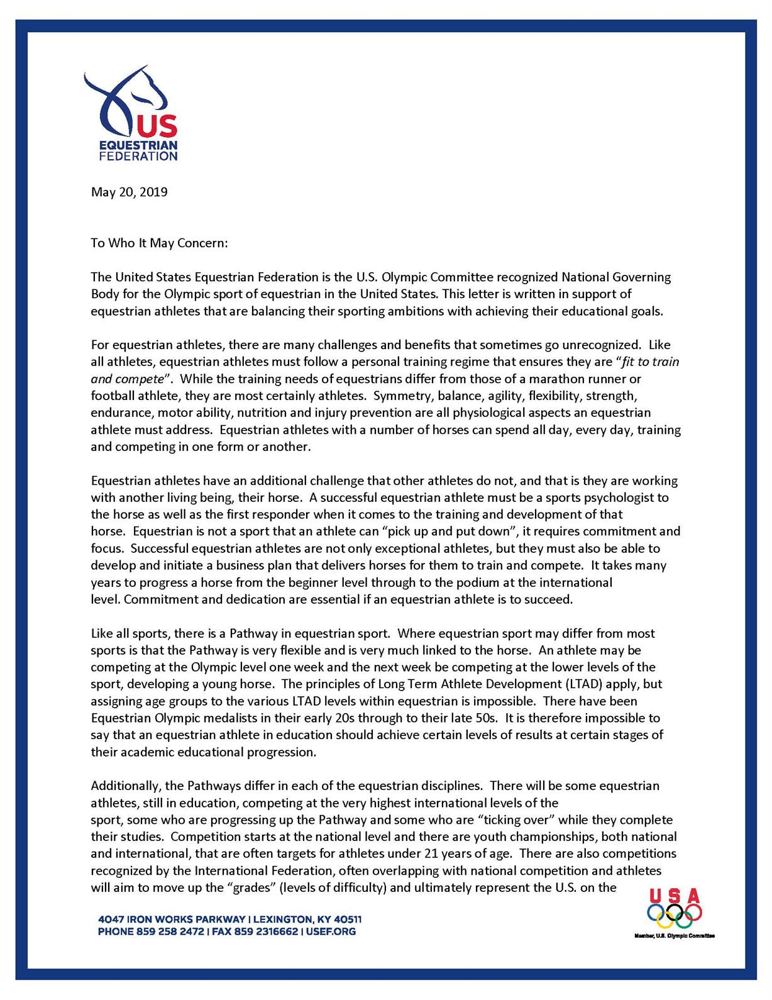
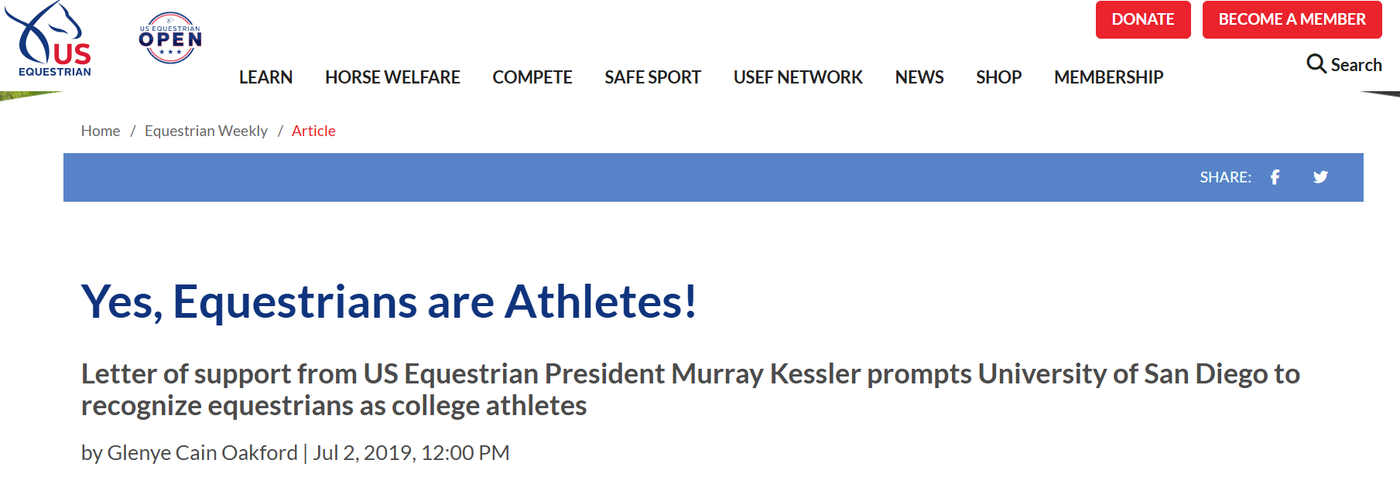

Slide 13
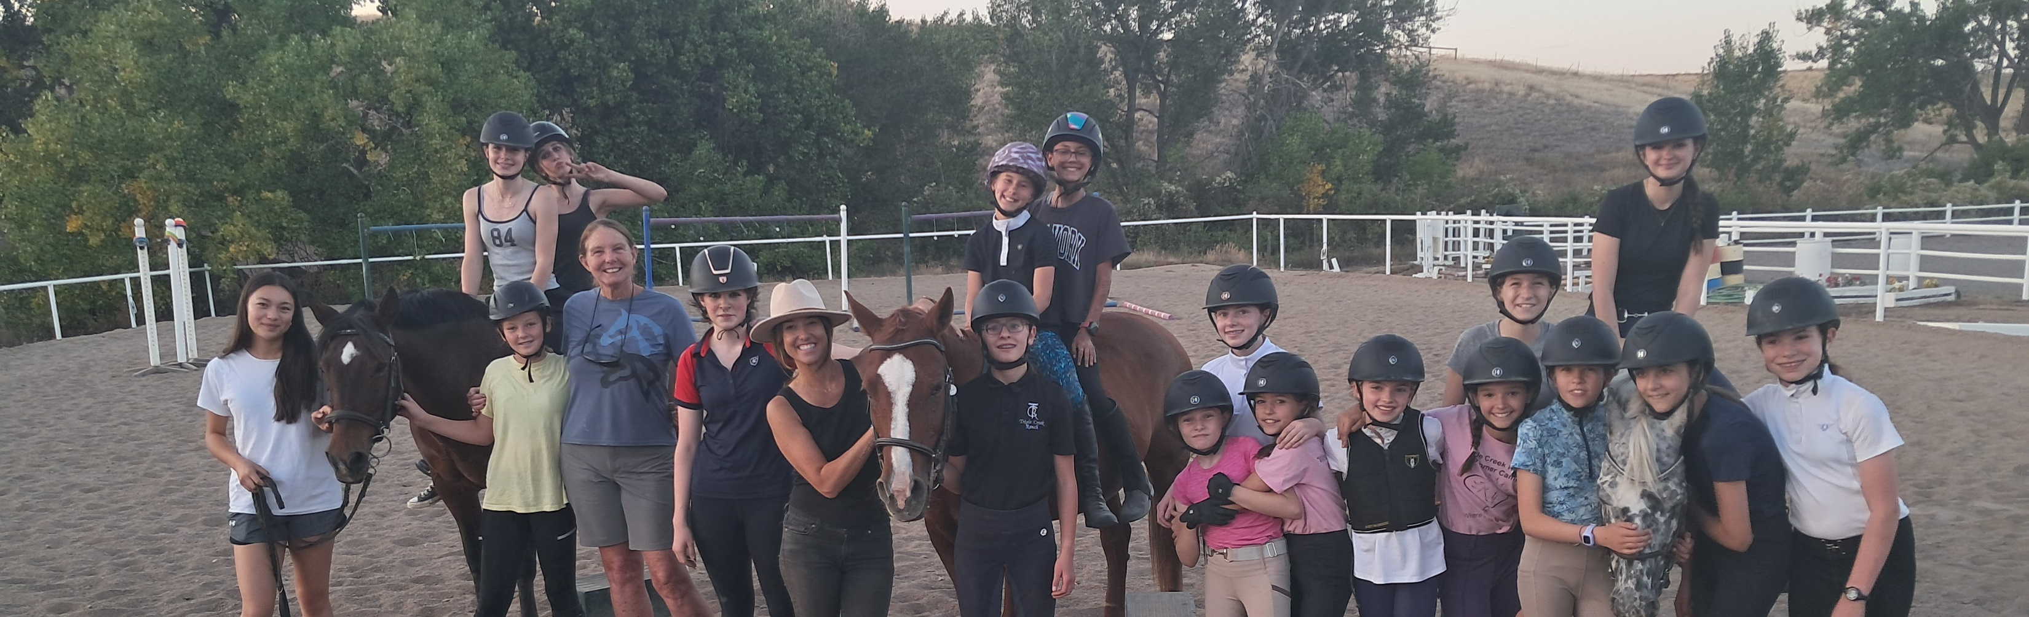
Staying Strong in the Saddle:
Challenging Beliefs
The higher level and the longer you are as an equestrian, the more likely you are to consider yourself an athlete.
But you have to make it there and last! So how do we keep you healthy?
Equestrians ARE athletes.
Because they are athletes, they need to treat their bodies, both physically and mentally, the way athletes do.
Partnership between rider and horse can only happen if BOTH partners are safe and healthy.
Sometimes it doesn’t make sense to just “get back on the horse.”

Slide 14
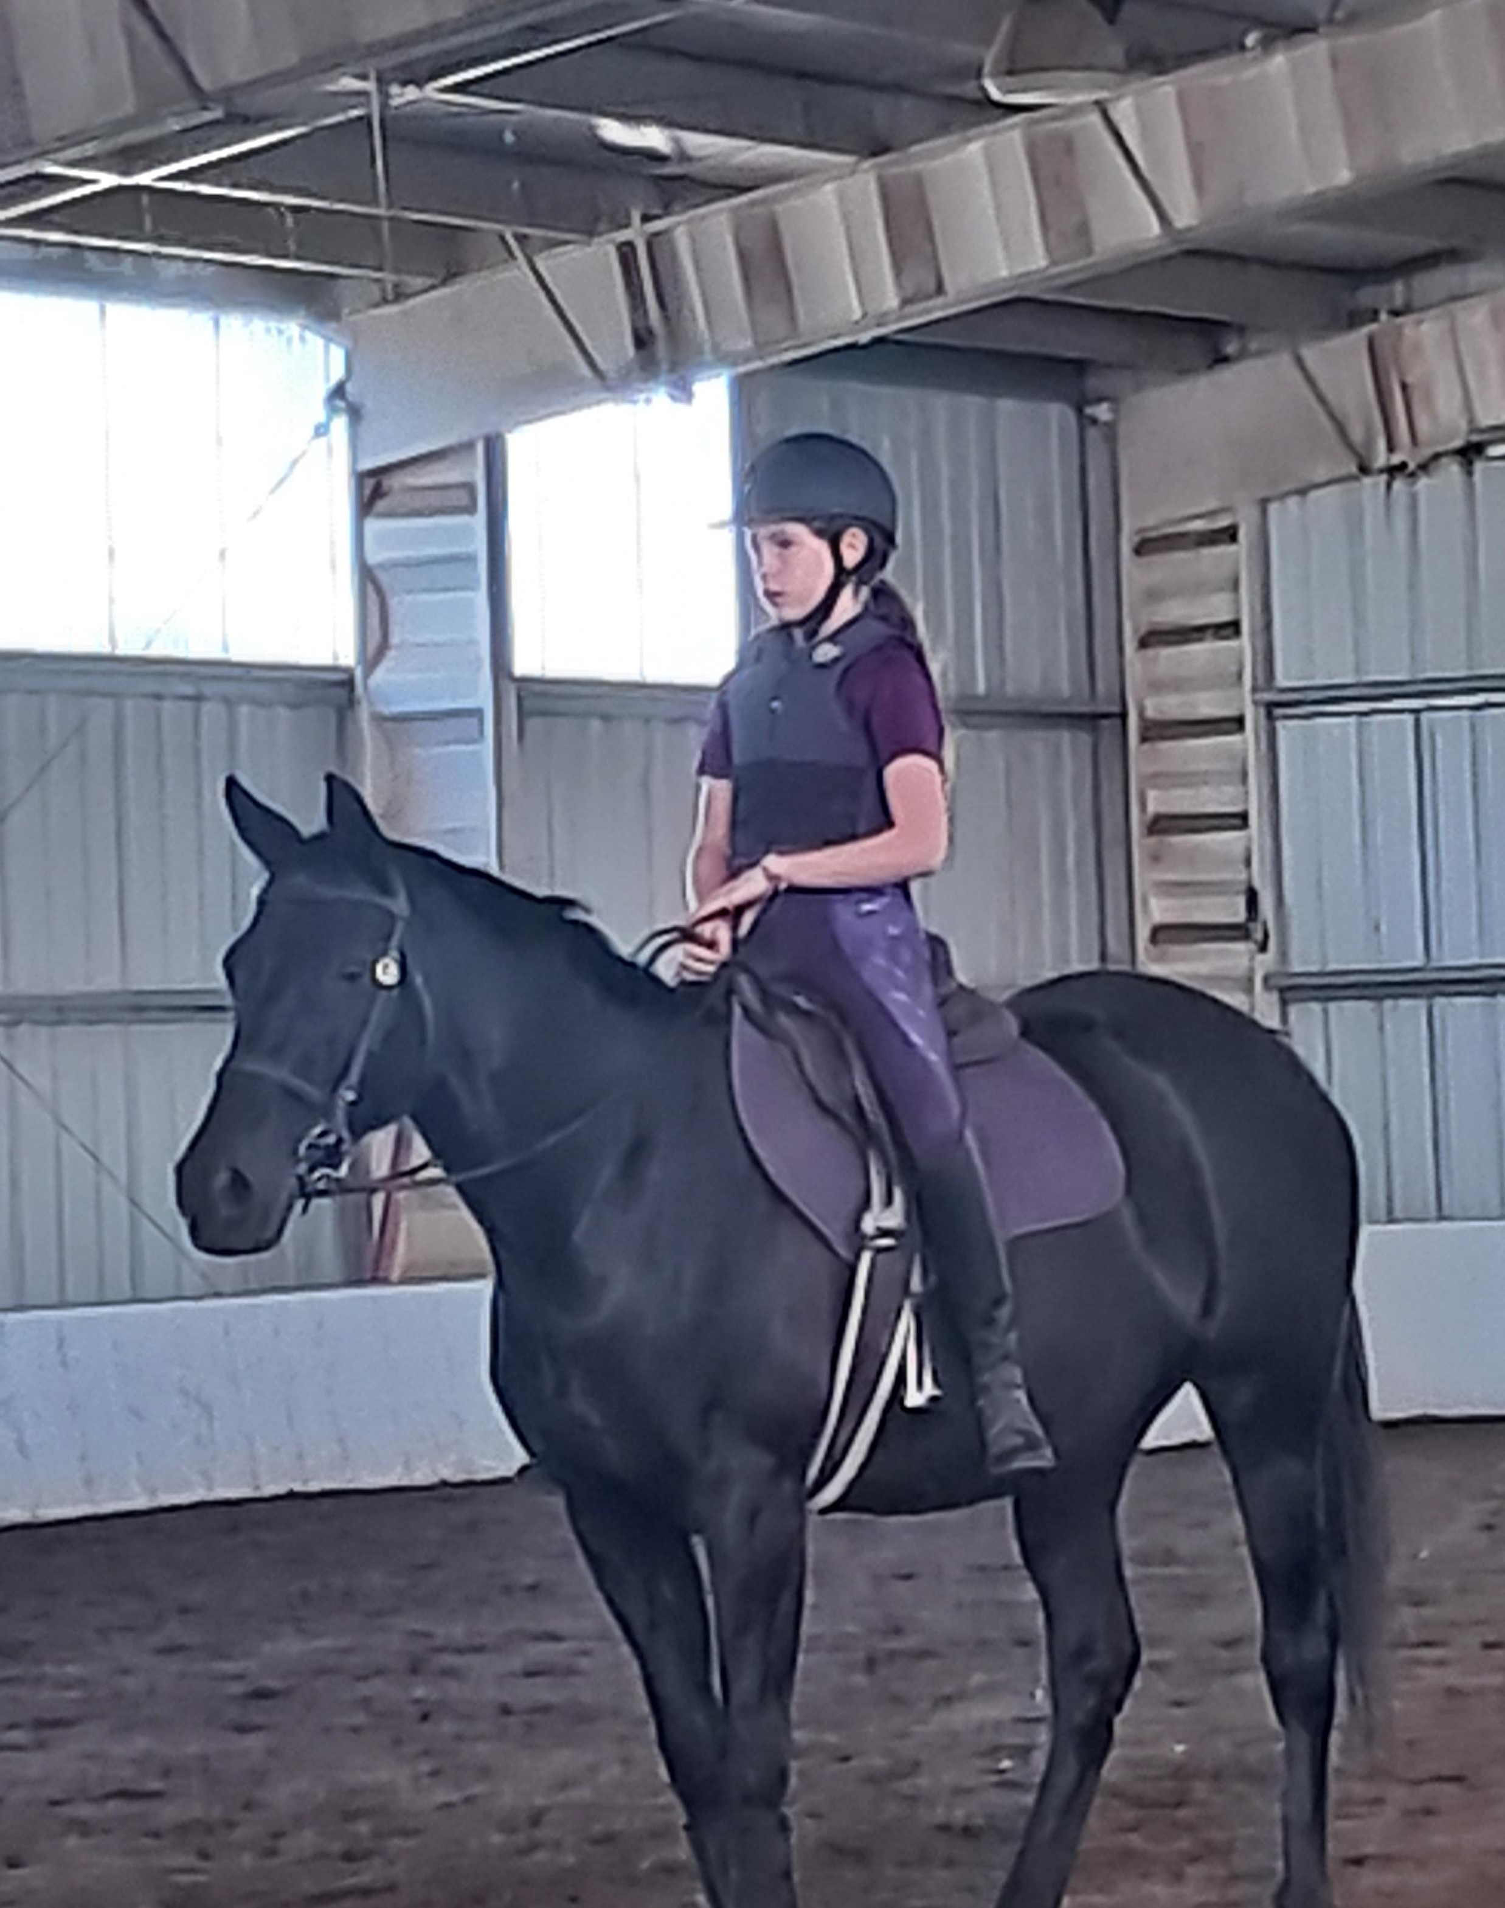
Belief #3
“There isn’t anything you can do to prevent injuries. They just happen.”
What do we know about equestrian injuries?
  Gender distribution and injury patterns depend on the discipline
  Age of injury varies as equestrian sports are lifelong
  Can occur in competition, leisure activity, practice, unmounted equestrian activity
  Environmental conditions
  Modifiable risk factors
  Experience
FALLS = #1 cause of injury
  Unexpected horse behaviors, in the saddle or unmounted activity
  Handling horses on the ground
  Unmounted horse activity

Slide 15
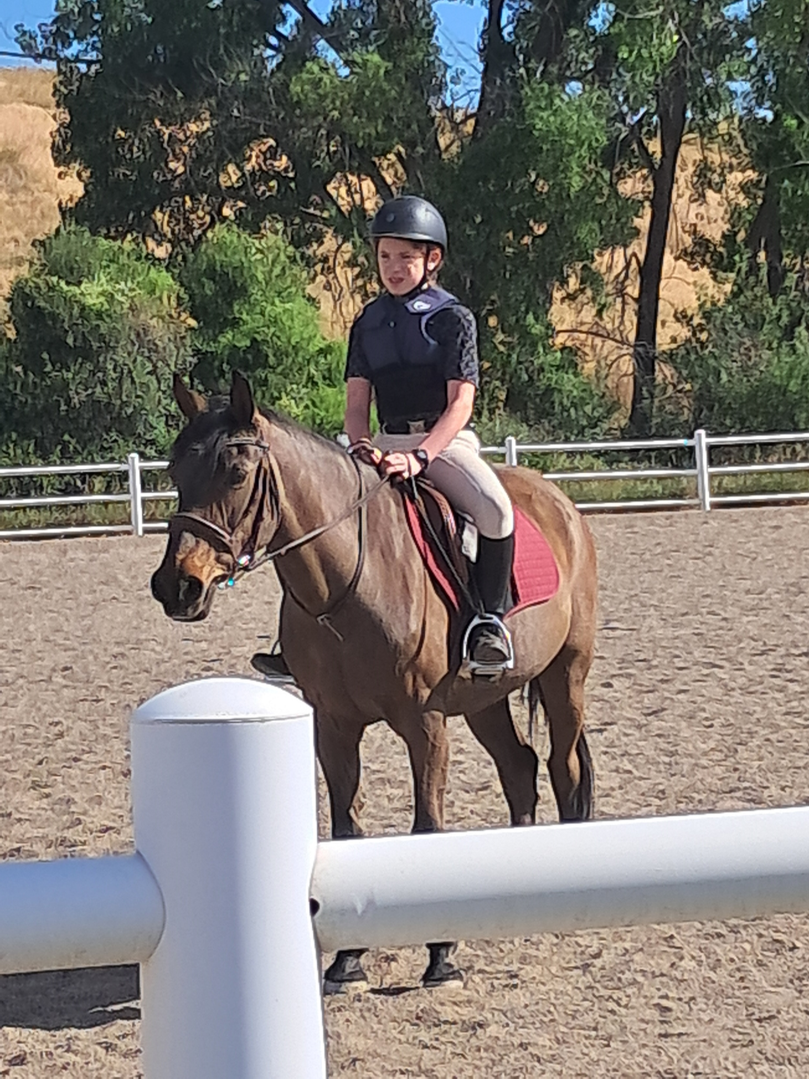
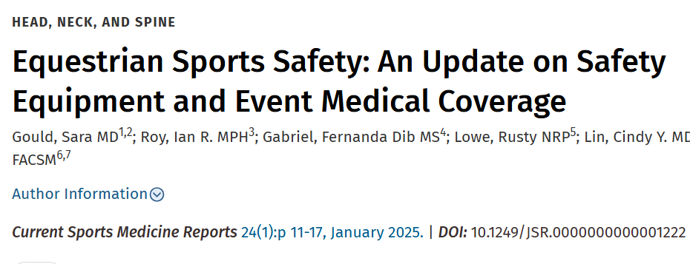
Belief #3
“There isn’t anything you can do to prevent injuries. They just happen.”
Falls = #1 cause of injury
  PREVENTION!
  Modernization of equestrian sports
    Improved helmets
    Safety vests
    Properly fitting horse tack
    Safety tack
    Noise dampening horse ear bonnets or earplugs
  Appropriate rider-horse match
    Emergency dismounts, knowing how to fall
  Education
  Proper use of equipment and tack

Slide 16
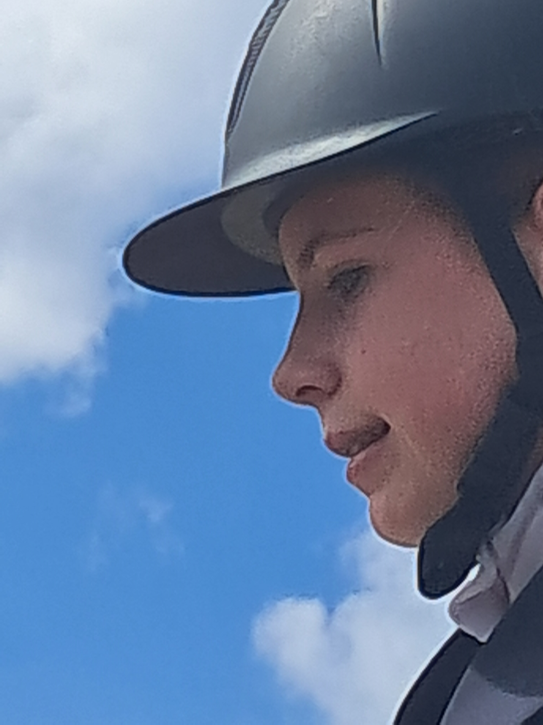
Belief #3
“There isn’t anything you can do to prevent injuries. They just happen.”
Helmets
  Not required for all equestrian activity
    Only mandated by several states
    No uniform European Union law on helmet use
      UK, Germany, & other countries laws for pediatric use
  Mounted and unmounted horse activity
  Helmets reduce head injury severity but not necessarily the incidence of head injury
    Not wearing helmet more likely to sustain intracranial hemorrhage
    In Olympic equestrian disciplines, the use of helmets vs previous eras when they were not required has shown a fivefold decrease in the risk of traumatic cerebral hemorrhage, reduced severity of traumatic brain injuries (TBIs), and reduced length of associated hospital admissions
    Some studies have shown inconsistent use of helmets as well as improper fitting of helmets
  **WATCH OUT FOR CONCUSSION**

Slide 17
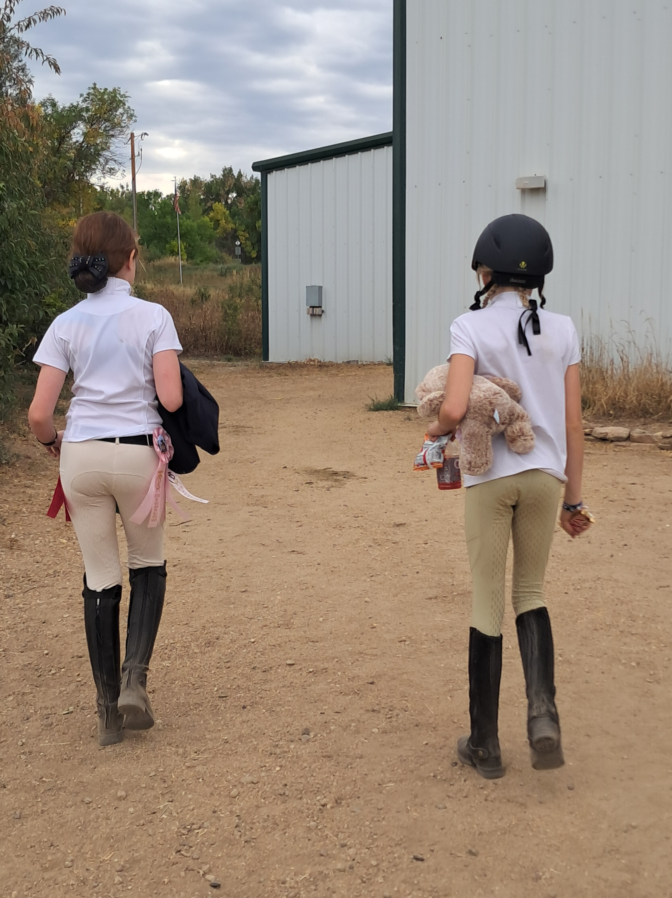
Belief #3
“There isn’t anything you can do to prevent injuries. They just happen.”
Injury patterns
  Increased use of helmets is improving and changing head injury
  Potentially change to more extremity fractures
Types of injury
  Head injury
  Extremity fractures
  Lacerations/soft tissue contusions
  Chest injury
  Facial injury
  Abdominal injury
  Spinal cord injury/spinal fractures

Slide 18
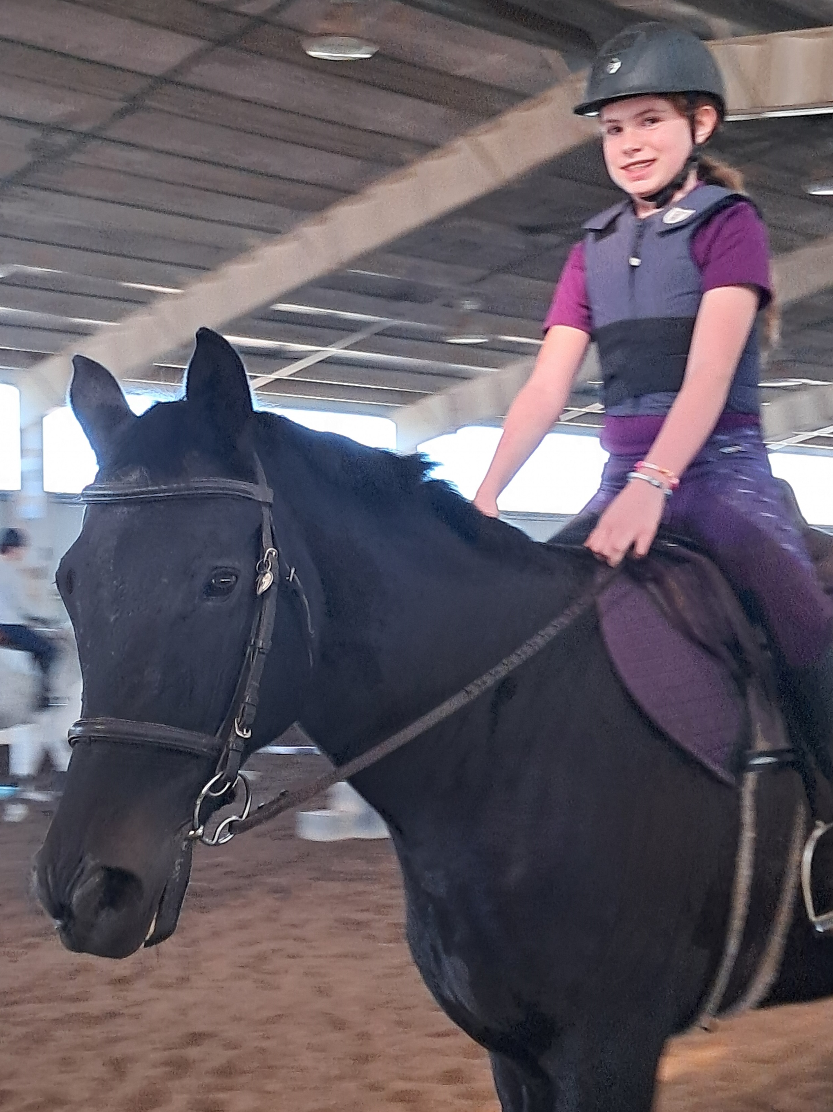
Belief #3
“There isn’t anything you can do to prevent injuries. They just happen.”
Safety vests
  Low level of use among the general equestrian population
  Studies variable, need more studies
  Cross-country equestrians decreased injury rates and lowered severity of injury
  ** Cervical spine is not protected, leaving it at risk**
Safety vests are mandatory in cross-country phase of three-day Eventing.

Slide 19
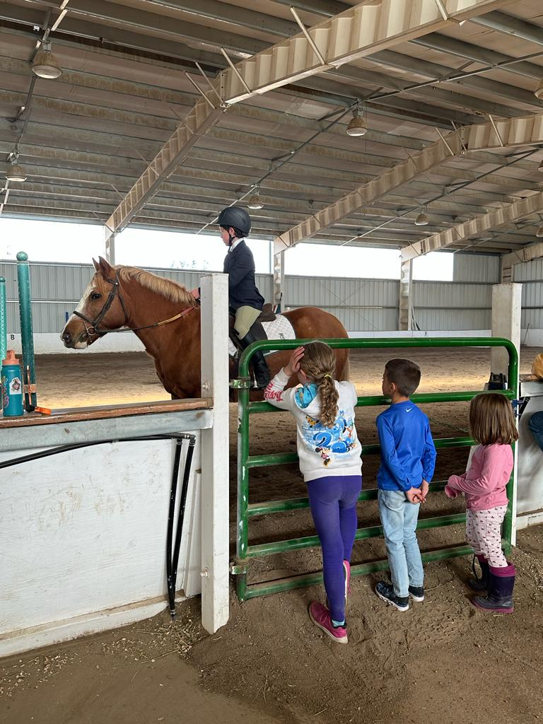
Belief #3
“There isn’t anything you can do to prevent injuries. They just happen.”
Wearing an approved medical wristband containing the rider's name, contact number, allergies, and serious medical conditions can be helpful in the event of a medical emergency.

Slide 20
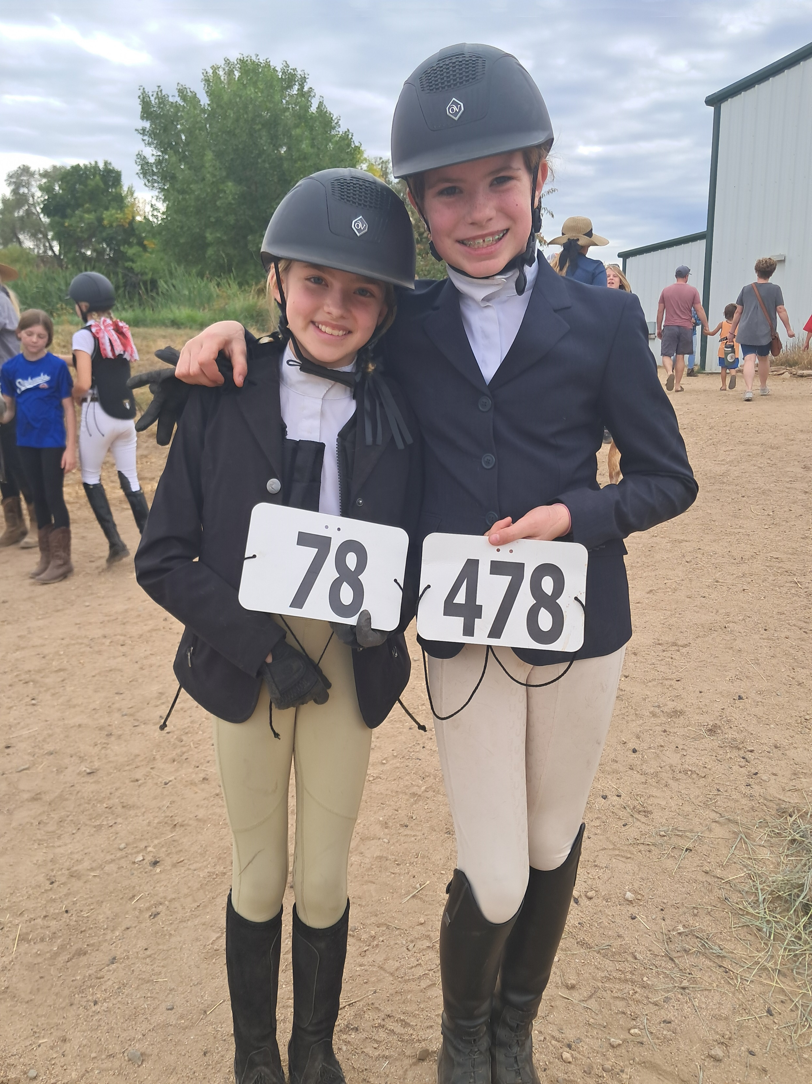
Belief #3
“There isn’t anything you can do to prevent injuries. They just happen.”
Event Management
  Not standardized or recognized nationally
  Depends on the discipline and level
  Consideration of the type of event and injury risk
  Equestrian events carry a high risk of injury and more specifically higher levels of injury
    More severe head and neck injury
    Larger fractures such as pelvic fractures which can bleed more and carry secondary consequences

Slide 21
Benefit #3
“There isn’t anything you can do to prevent injuries. They just happen.”
Emergency Action Plan (EAP)
  Higher levels of competition
  USEF and FEI require events to have an EAP
  Three primary roles of an EAP
    medical stabilization for transfer of patients requiring further medical intervention
    triage and avoidance of unnecessary transfers via emergency medical services (EMS)
    basic first aid for participants
      spectators, and other event participants (if offered)
  **THIS IS A MODIFIABLE RISK FACTOR**

Slide 22
Belief #3
“There isn’t anything you can do to prevent injuries. They just happen.”
Emergency Medical Coverage
  Emergency Medical Technician vs Certified Athletic Trainer
Transport considerations
Access and safety of the covering medical provider
Horse safety
AED (Automated External Defibrillator)
Barn Emergency Medical Bag
  What different equipment do you need?
BLS (Basic Life Support)
  Hands only CPR

Slide 23
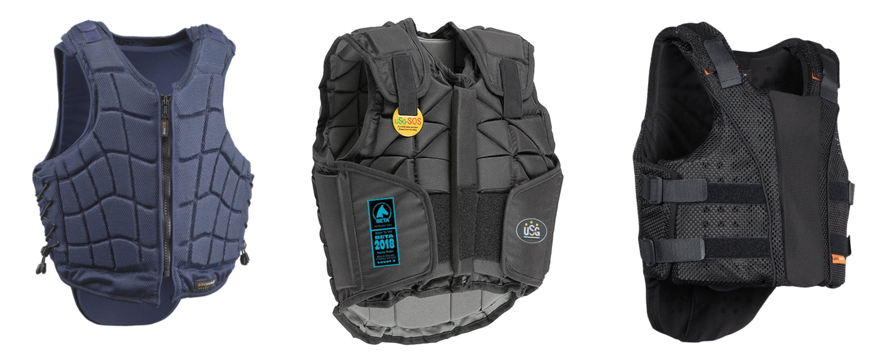
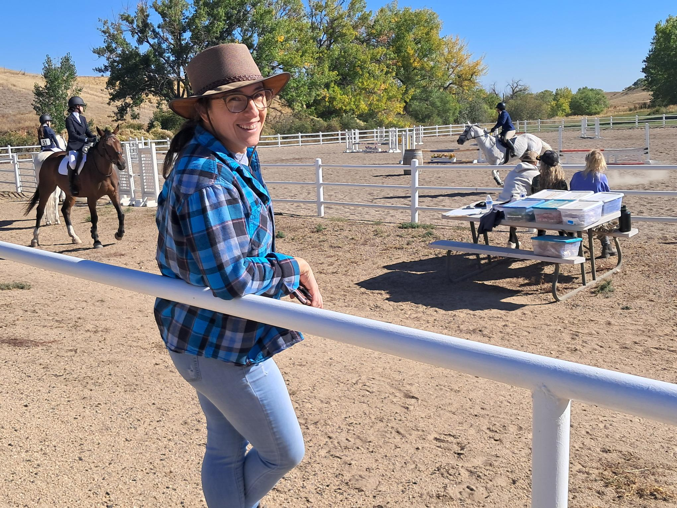
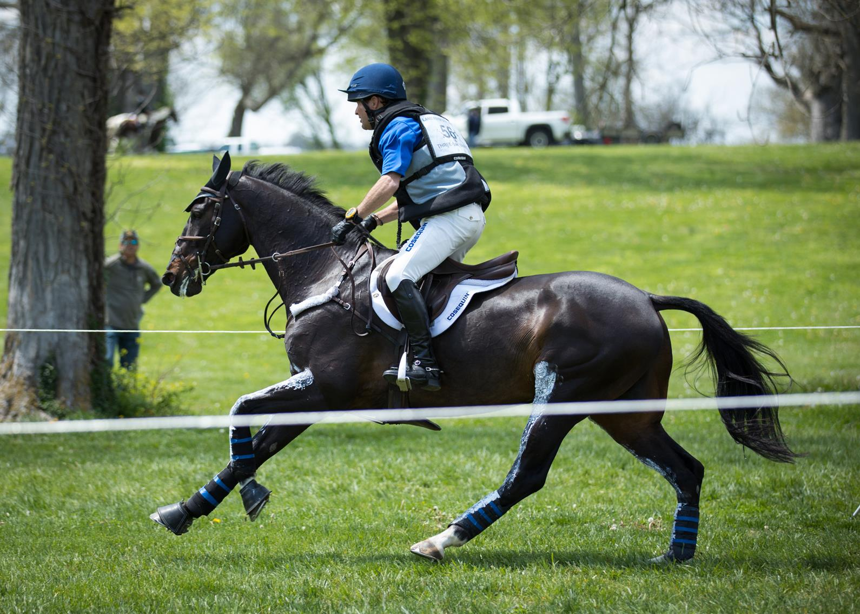

Slide 24
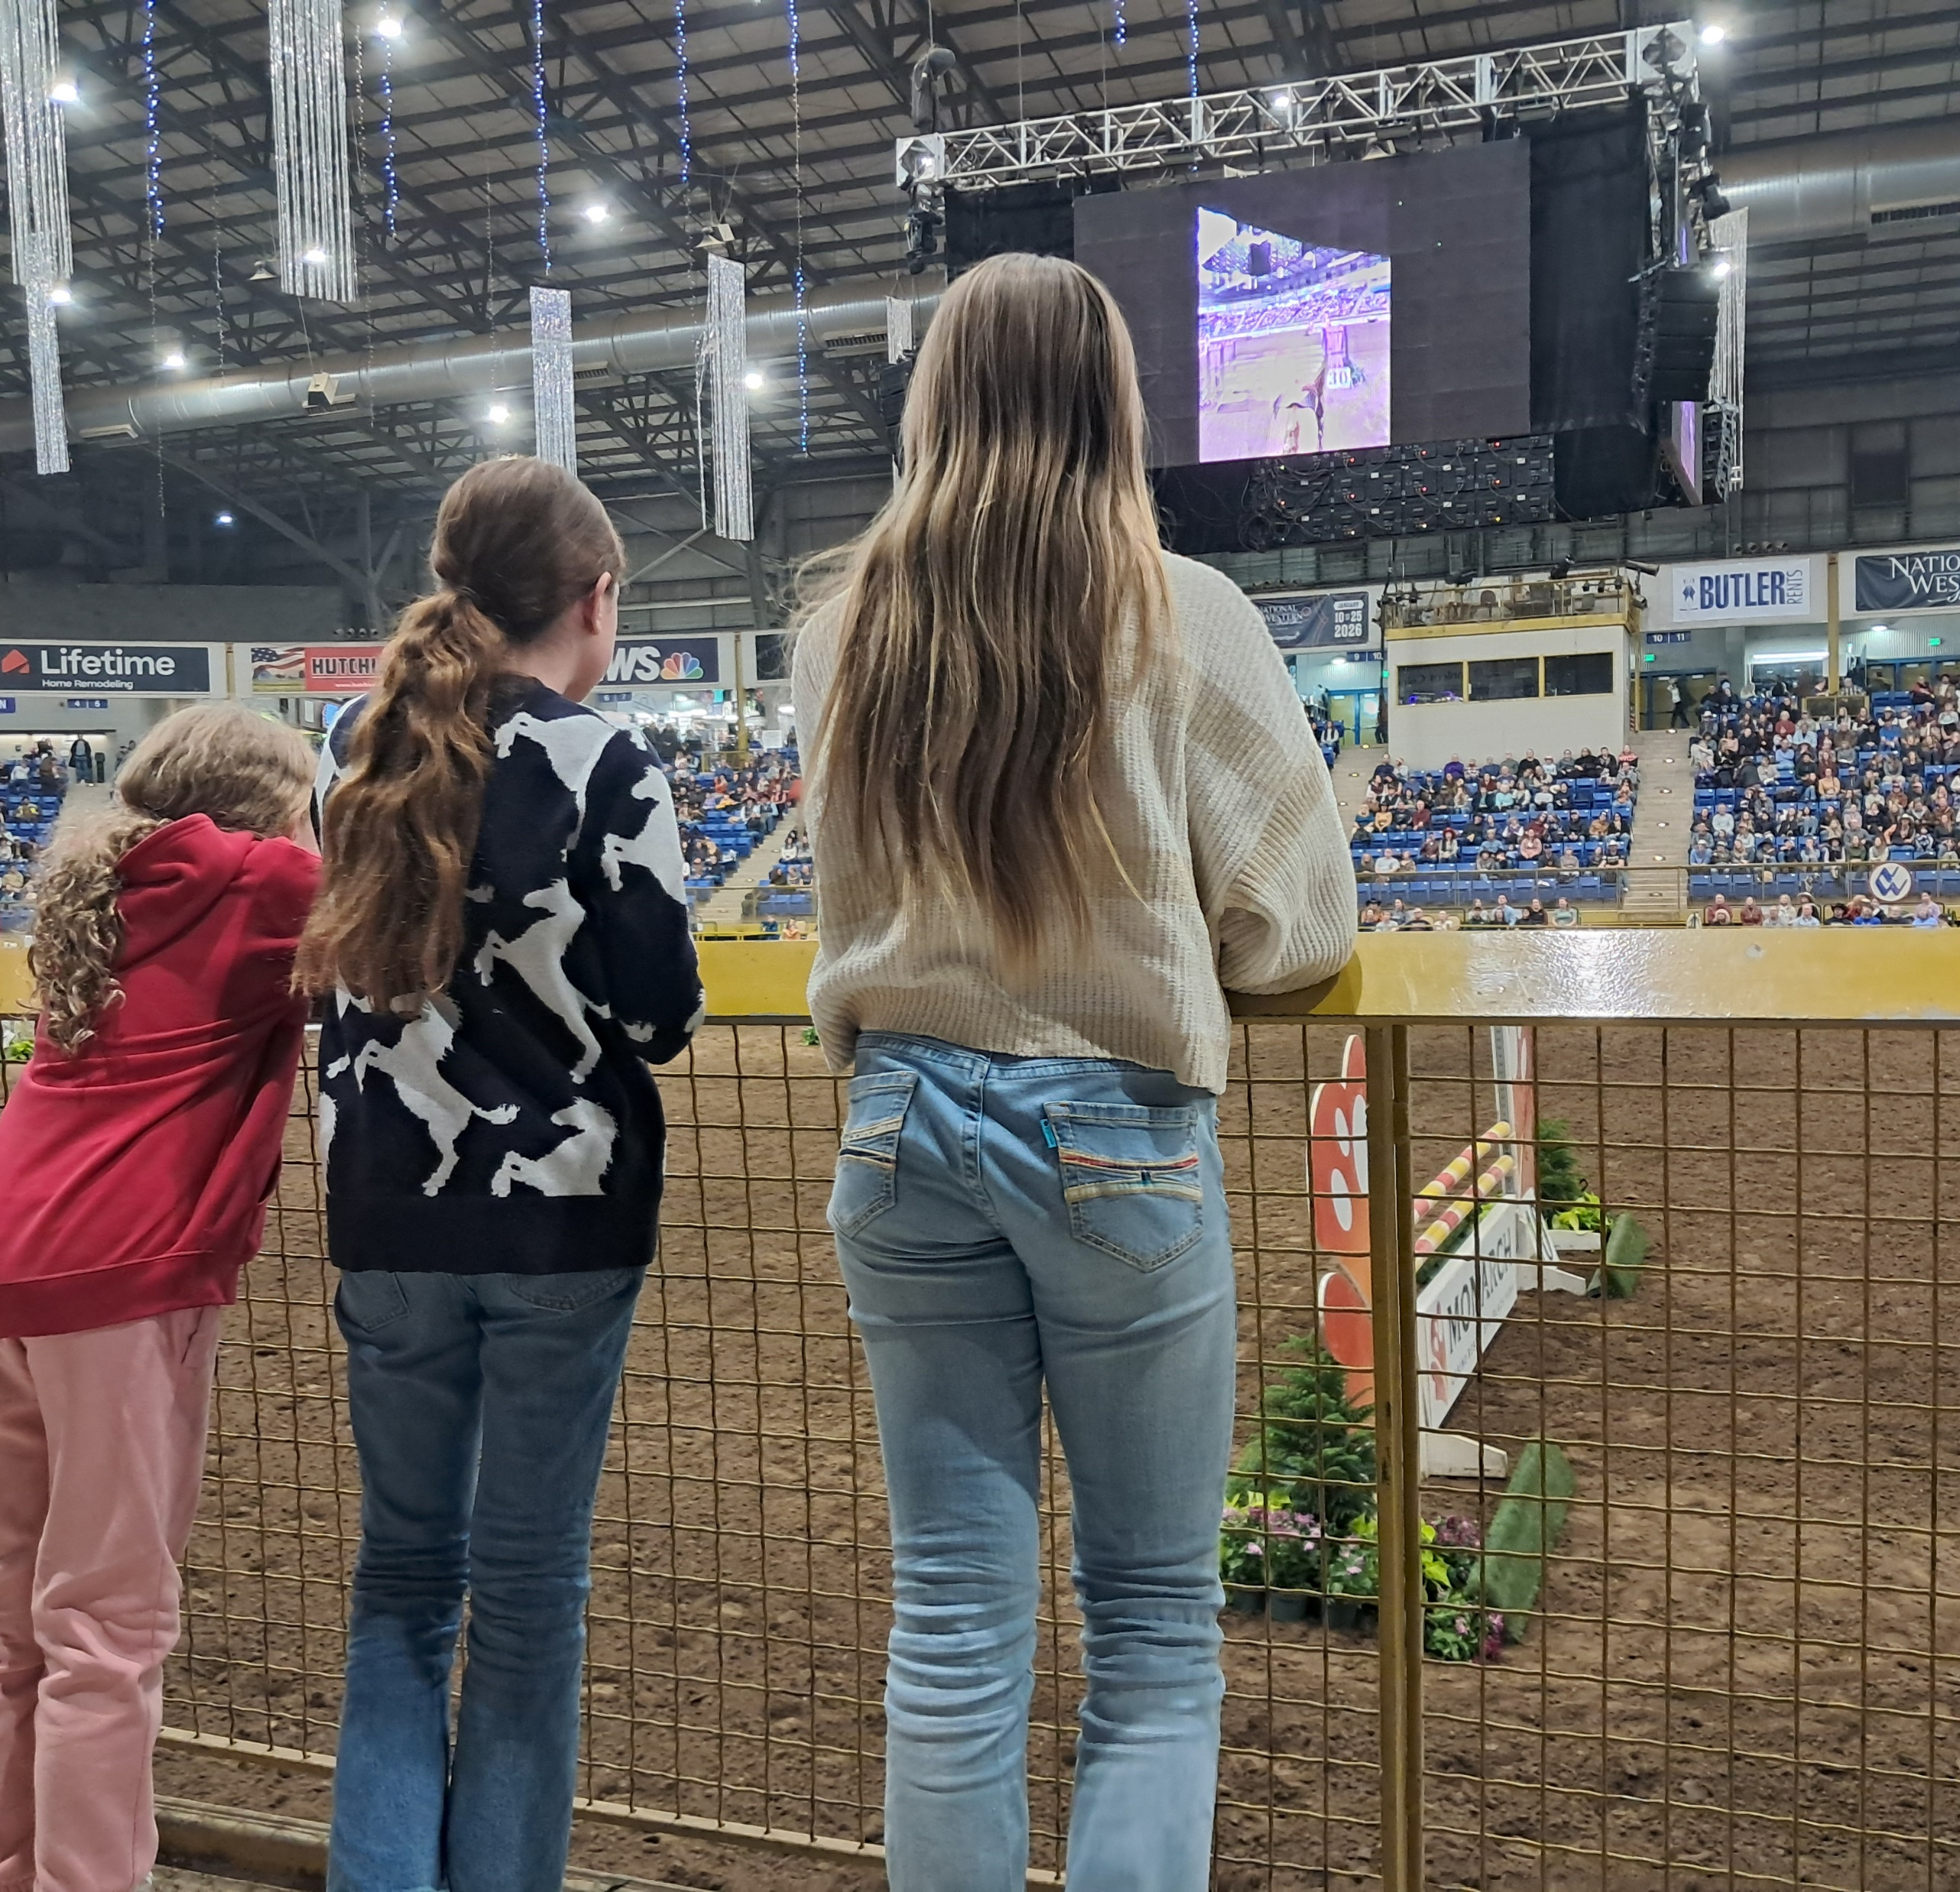
Staying Strong in the Saddle:
Challenging Beliefs
Injuries will happen in Equestrian sports
  Head, abdomen, chest and fractures
There are things we can do to help prevent them from happening as well as decrease the severity of them
Proper safety equipment for rider and horse
Emergency Preparedness
Barn Emergency Medical Bag
Creation of Emergency Action Plans
  Practice EAPs

Slide 25
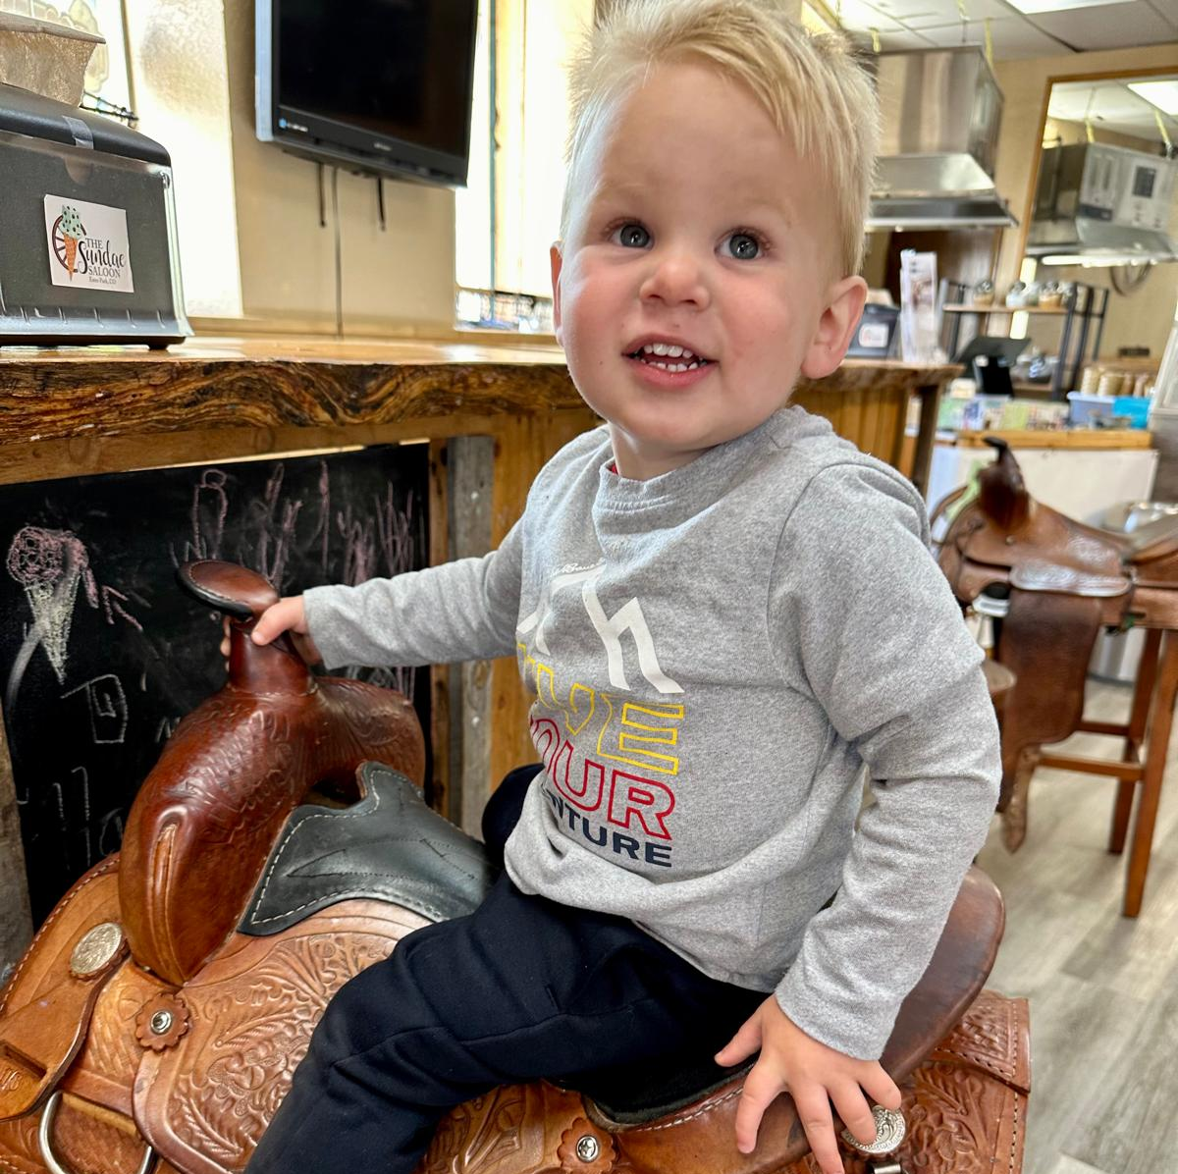
Belief #4
“I don’t need an exam to start equestrian sports.”
What’s a PPE (pre-participation exam)?
There are three different meanings for PPE
  Pre-purchase exam
  Pre-participation exam
  Personal Protective Equipment

Slide 26

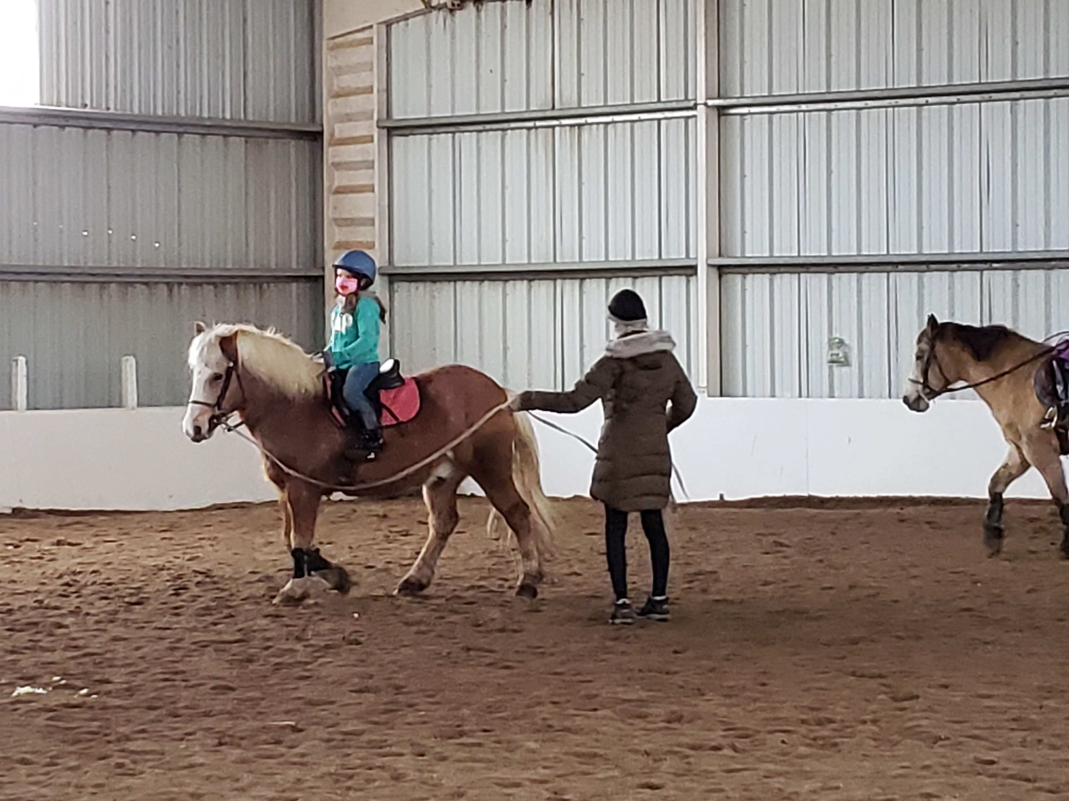
Staying Strong in the Saddle:
Challenging Beliefs
Pediatric and adult equestrians should be informing their primary care providers they ride horses.
Referral to Sports Medicine provider who can help you have a plan ahead of time for injury and events, treat injury and provide physical therapists to assist with treatment and recovery.

Slide 27
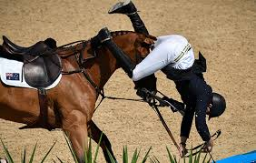
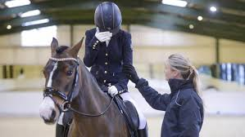
Belief #5
“I think I got a concussion, but I don’t know what to do or who to tell. I guess I will keep riding. There is nothing to do for concussion anyway.”
Horseback riding is a leading cause of sports-related traumatic brain injury in the United States.
  Above football, rugby and ice hockey
However, most concussions occur in private settings where concussions are not tracked.
THIS IS AN ENTIRE UPCOMING LECTURE:
  August 26th - Best Ways to Handle Sports Concussions

Slide 28

Belief #5
“I think I got a concussion, but I don’t know what to do or who to tell.
I guess I will keep riding. There is nothing to do for concussion anyway.”
Rapid fire:
  Can occur WITH or without helmet on
  You don’t have to hit your head, can be whiplash mechanism
  “Sport Related Concussion”
  “Gradual Return to Play”
  “Return to Learn”
  May or may not involve LOC (loss of consciousness)
  The sooner athletes are treated, the faster they get better
  Symptoms can be immediate, evolve over minutes to hours
  Commonly resolve within days but can be prolonged
  No abnormality seen on standard imaging

Slide 29
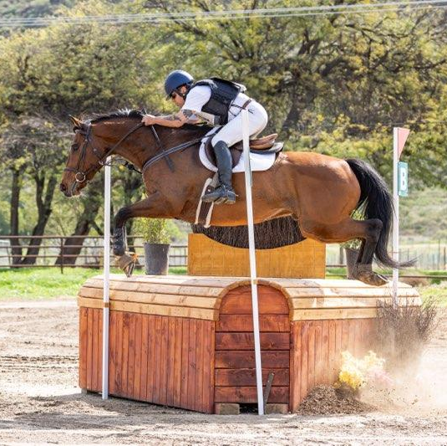
Belief #5
“I think I got a concussion, but I don’t know what to do or who to tell.
I guess I will keep riding. There is nothing to do for concussion anyway.”
The ER is not where definitive management occurs
Needs outpatient management
Really need written communication between health care providers and trainers/barns
ACTIVE management

Slide 30
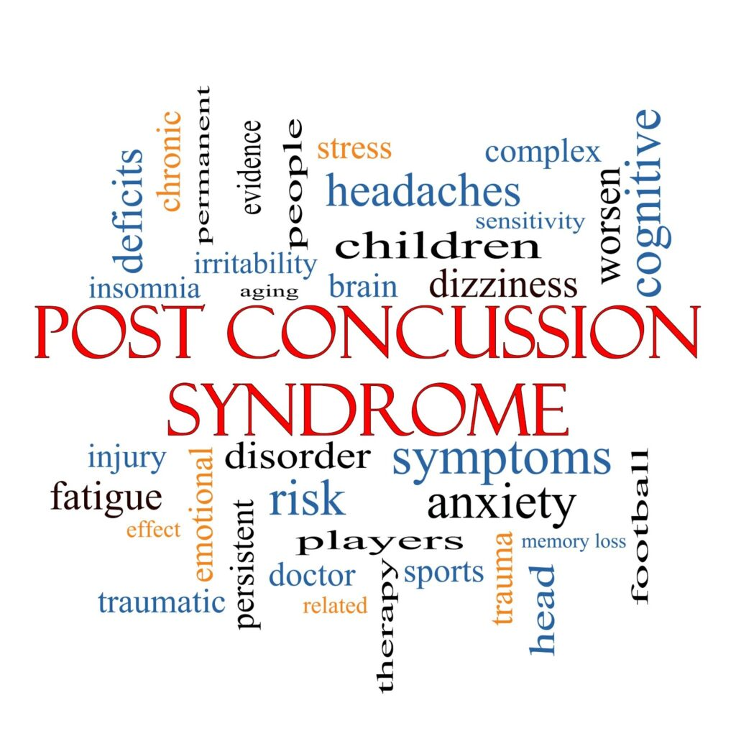
Belief #6
“Ever since that one concussion years ago I have never been the same…oh well. There isn’t anything to do about it.”
Consequences of not getting concussion addressed soon can lead to long-lasting effects
Vertigo/balance issues
Mood disturbance/mental health compromise
Loss of sport
Loss of identity and psychological secondary causes
Impaired ability to read and use brain effectively

Slide 31
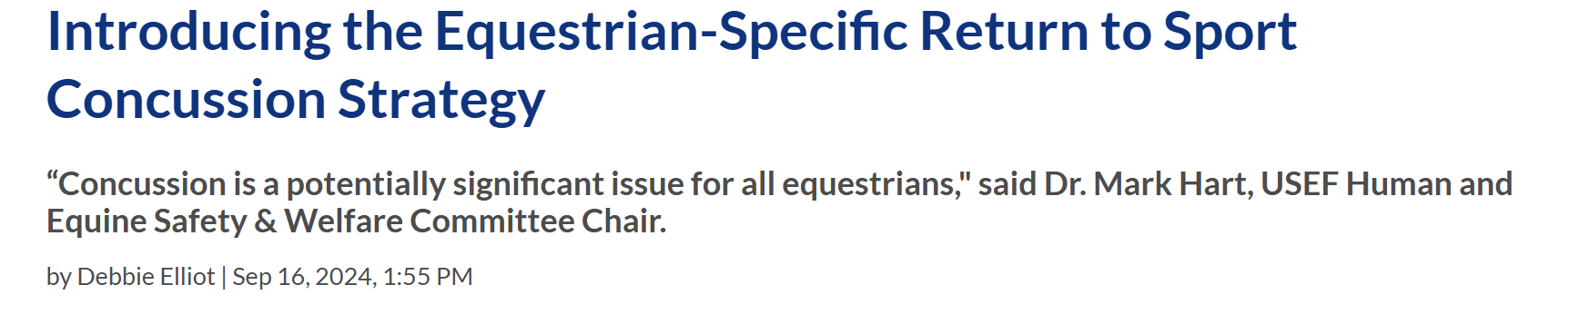
Equestrian Gradual RTP

Slide 32
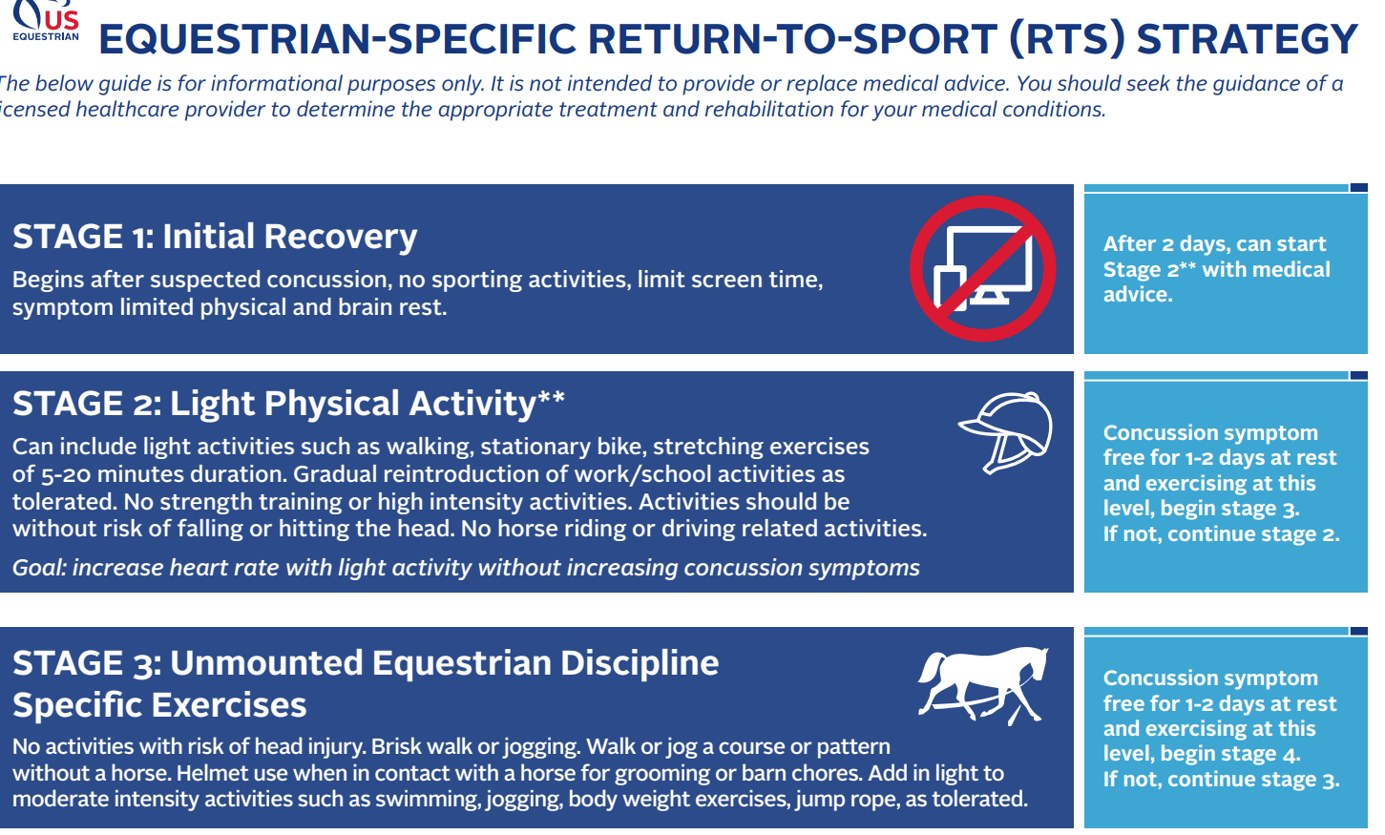
Equestrian Gradual RTS

Slide 33
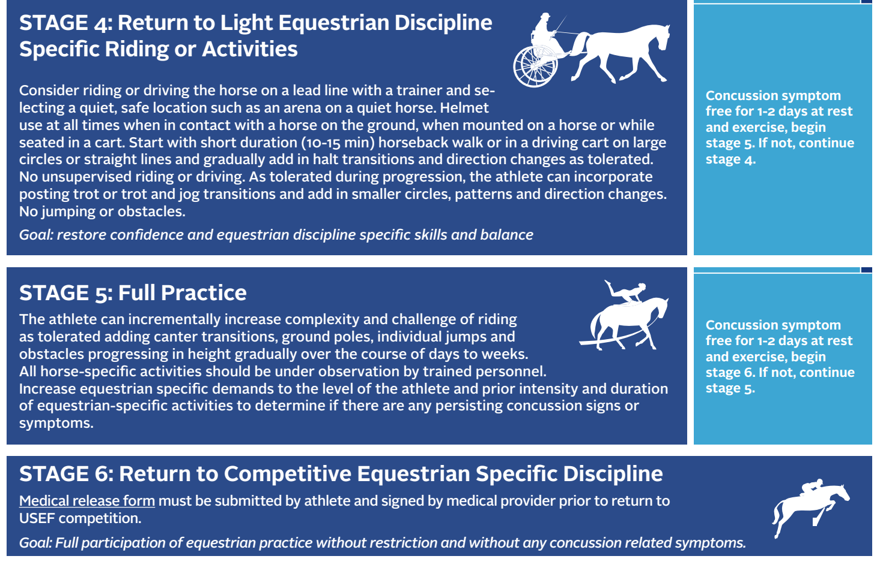
Equestrian Gradual RTS

Slide 34


Sport Related Concussion:
Equestrian
Removal of rider
  Immediate removal: actual or suspect LOC, seizure, tonic posturing, ataxia, poor balance, confusion, behavioral changes & amnesia
No return unless evaluated by HCP experienced in concussion management
Maddocks questions
  Sports specific questions/riding specific questions
NO RETURN THE SAME DAY
Laws in every state
  Jake Snakenburg Law

Slide 35

Staying Strong in the Saddle:
Challenging Beliefs
Concussions happen frequently but with correct rider and barn education long-term consequences can be prevented.
NEVER RETURN TO RIDING ON THE SAME DAY OF POTENTIAL CONCUSSION.
Prompt evaluation and management can lead to success both short-term and long-term.
EDUCATE, RECOGNIZE AND REMOVE!
There is treatment for concussion, including use of multi-disciplinary team, where everyone is involved: rider, trainer, and health care team.

Slide 36

Belief #7
“I had a fall and now I am scared to get back on…”
Psychological effects of concussion and other injury
  Did you really recover?
  Never coming back to your baseline can change the way you ride
Does it put you at increased risk for future injury?
  YES! Newer studies show increased risk for another injury within 6 months of getting a concussion
How are you modifying your riding now?
Does your horse feel your nerves?
Who can you talk to about how your injury has changed you?
Are you on the right horse?

Slide 37


Belief #8
“Oh, years ago I fell off a horse. I just kept riding. Nothing to do anyway.”
Many, if not most, injuries do get better the sooner you treat them
Consequences of not treating injury correctly
  Arthritis
  Loss of range of motion
  Chronic pain
Return to play considerations
Kids think they are invincible and don’t think about consequences for the future
Pay for it later in life

Slide 38


Belief #8
“Oh, years ago I fell off a horse. I just kept riding. Nothing to do anyway.”
Joint issues for the young and old
  Fractures
  Arthritis
  Nerve entrapment
Joint issues, including spine, effects the way you sit in the saddle.
Early identification of joint and spine issues not only can assist with how you sit in a saddle but how you control your body.
Pain, both acute and chronic, changes the way you hold your body and activate your muscles.
  Altering the way you ride and what your horse feels.

Slide 39

Belief #8
“Oh, years ago I fell off a horse. I just kept riding. Nothing to do anyway.”
Knee injuries: sprains, subluxation, dislocations, fractures
  Can lead to arthritis if not treated
  Early treatment means activity modification, proper diagnosis, physical therapy, injections, bracing, taping
  Strengthening, joint proprioception, stability
  Injections: Visco supplementation and regenerative medicine like Platelet Rich Plasma
Core stability and strengthening
Hip strengthening
Spinal motion awareness
Rider preparation: warm up and cool down for rider, not just the horse!

Slide 40

Staying Strong in the Saddle:
Challenging Beliefs
Early identification of an injury allows for proper diagnosis and treatment for kids and adult riders.
Getting in to the doctor sooner rather than later can help return to riding sooner and also prevent future consequences.
Proper injury management decreases future injury risk.
Addressing injury sooner rather than later decreases psychological consequences that can create fear of riding, altered relationship with your horse, and decreased rider enjoyment of the sport.
Learn who your health care team is and USE THEM!

Slide 41

Belief #9
“Ever since that one fall, I can’t ride anymore. I am so sad.”
Psychological considerations for getting back on the horse
Performance anxiety
Getting hurt again
“One too many”
Fear of the unknown
Riders don’t tell doctors they ride horses as they don’t identify as athletes or they don’t want to be told they can’t ride.

Slide 42

Belief #9
“Ever since that one fall, I can’t ride anymore. I am so sad.”
Injury treatment then moves into injury prevention and sports performance
  Home programs
  Rider warm up and cool down
  Better understanding of rider pathology leads to better rider mind/body connection and body mechanics
    This empowers both horse and rider
Return to play for specific injuries
Ride well, ride safe.

Slide 43

Belief #10
“I’m an equestrian, I expect to have these issues with my body.”
Exercise programs for prevention and treatment
  Based on previous injuries and progression of previous injuries
  Functional movement assessments
Incorporating rider-specific exercises and workouts improves rider performance and equipoise in the saddle
  Focusing on important aspects like postural strength, stability, and mobility
How you sit in the saddle
  Influenced by your spine mechanics, hip anatomy
  Neuromuscular firing patterns
  Increasing body awareness

Slide 44

Staying Strong in the Saddle:
Challenging Beliefs
By equestrians identifying themselves as athletes, they can identify problems earlier to prevent long-term physical and psychological issues.
This can keep them riding longer as the equestrian sports are truly life-long.
Understanding how sports medicine physicians can help equestrians continue to stay strong and healthy in the saddle is essential.
Education and real dialogue between rider and health care professional makes for true success.
Early education of riders, parents, trainers and barns on safety and emergency preparedness can truly decrease injury and decrease severity of injury.

Slide 45


Staying Strong in the Saddle:
Challenging Beliefs
“Sports Medicine is not just for young competitive athletes. As an older person trying to keep going and stay fit, my Sports Medicine doctor treats me with compassion, understanding and collaboration of how to get back on track. It’s a two-way dialogue, which is important to me.”
“Sports Medicine doctors understand the psychology behind being injured and having active personal goals. After the ability for my body to function optimally was compromised seeing a Sports Medicine doctor helped me develop a comprehensive game plan to reach my activity goals.”
“From orthopedics and physical therapy to metabolic evaluation and concussions, Sports Medicine is a more comprehensive medical specialty.”

Slide 46

Staying Strong in the Saddle:
Challenging Beliefs – The Athlete Voice

Slide 47




Staying Strong in the Saddle:
Challenging Beliefs
Bonus Belief: Once you lease a horse, your kid will be content.
No, that’s MYTH! Then they want to BUY a horse!
And then, another, then, another…

Slide 48





Slide 49



Thank you!
CU Sports Medicine & Performance Center staff
Triple Creek Ranch
US Equestrian
Horse families
The Winter Family
The Thomas family
All of our horses
Horse lovers everywhere
My mom

Slide 50
References
Gould S, Roy IR, Gabriel FD, Lowe R, Lin CY. Equestrian Sports Safety: An Update on Safety Equipment and Event Medical Coverage. Curr Sports Med Rep. 2025 Jan 1;24(1):11-17. doi: 10.1249/JSR.0000000000001222. PMID: 39749953.
Glace BW, Kremenic IJ, Hogan DE, Kwiecien SY. Incidence of concussions and helmet use in equestrians. J Sci Med Sport. 2023 Feb;26(2):93-97. doi: 10.1016/j.jsams.2022.12.004. Epub 2022 Dec 23. PMID: 36609086
Introducing the Equestrian-Specific Return to Sport Concussion Strategy | US Equestrian
equestrian-specific-return-to-sport
10 Benefits of Horseback Riding
Gates, Jennifer K. BA; Lin, Cindy Y. MD, FACSM. Head and Spinal Injuries in Equestrian Sports: Update on Epidemiology, Clinical Outcomes, and Injury Prevention. Current Sports Medicine Reports 19(1):p 17-23, January 2020. | DOI: 10.1249/JSR.0000000000000674
Keener MM, Tumlin KI, Dlugonski D. Self-Reported Physical Activity and Perception of Athleticism in American Equestrian Athletes. J Phys Act Health. 2023 Jan 20;20(3):169-179. doi: 10.1123/jpah.2022-0398. PMID: 36669501.

Slide 51


Slide 52
Equestrian Sports Medicine Injury Prevention & Recovery
Sherrie Ballantine-Talmadge, DO
CU Sports Medicine & Performance Center
Director of Outreach
720-680-3421

